Slide 1
DIPLOMA IN FIRE & SAFETY ENGINEERING (BSS- APPROVED BY GOVT OF INDIA)
(An ISO 9001-2008 Certified Safety Training and Consulting Organization)

Slide 2
NATIONAL SAFETY DAY – 4TH MARCH NATIONAL FIRE DAY- 14TH APRIL

Slide 3
WHY SAFETY ???
GLOBAL SAFETY STUDIES

Slide 4
WHY SAFETY???
MORAL
LEGAL
ECONOMIC & FINANCIAL

Slide 5
MORAL
BY THE CONSIDERING THE HUMANITARIEN REASON THE EMPLOYER HAVE THE MORAL RESPONSIBILITY TO PROVIDE SAFE & HEALTH WORK PREMICS , EQUIPMENTS & GOOD WORKING CONDITIONS..

Slide 6
LEGAL
AS PER THE LAW THE ORGANIZATION SHOULD FULL FILL THE LEGAL REQUIREMENT TO AVOID THE LEGAL PROTECTION LIKE COMPENSATION AND IMPRISONMENT ETC…

Slide 7
ECONOMICAL & FINANCIAL
WHEN THE ACCIDENT OCCURE THEIR WILL BE DIRECT AND INDIRECT COST ASSIGHNED WITH THAT EVENT..
DIRECT COST
INDIRECT COST

Slide 8
DIRECT COST
THE MESSURABLE COAST ARISING DIRECTLY FROM THE ACCIDENT.
DIRECTLY FROM THE ACCIDENT
FIRST AID COST
MEDICAL TREATMENT COST
COMPENSATION COST

Slide 9
INDIRECT COST
CANNOT BE MESSURED WHICH ARISED INDIRECTLY AS THE CONSEQUENS OF THE EVENT..
SALARY TO INJUIRED PERSON
REPLACEMENT WORKERS
TRAINING FOR NEW WORKERS
INVESTIGATIONS
LEGAL FEES
CLEANING COST
REPAIR OF PLANT

Slide 10
HSE
H- HEALTH
S- SAFETY
E- ENVIRONMENT

Slide 11
HEALTH
HEALTH IS A STATE OF COMPLETE PHISICAL, MENTAL AND SOCIAL WELL BEING NOT MERELY THE ABSENCE OF DISDASES OR INFIRMITY

Slide 12
SAFETY
SAFETY CAN BE DEFINED AS FREEDOM FROM THEIR CONDITION THAT CAN CAUSE INJURY OR DEATH TO PERSONAL DAMAGE OR LOSS OF EQUIPMENT AND PROPERTY

Slide 13
ENVIRONMENT
ENVIRONMENT MEANS THE SURROUNDING IN WHICH AS ORGANIZATION OPERATE INCLUDING AIR, WATER, LAND, NATURAL RESOURES, FLORA HUMAN AND THEIR INTER RELTIONSHIP.

Slide 14
DUTIES & RESPONSIBILTIES OF HSE OFFICER….
ENSURING COMPLANCE WITH RESPECT TO HEALTH, SAFETY, ENVIRONMENTAL AS PER THE COMPANY, PROJECT HSE PLAN & STATUTORY REGULATION.
ENSURING & MONITORING IMPLEMENTATION OF HSE POLICY & PLAN
INTRACTING & CORDINATING WITH CLIENT AND OTHER AGENCIES IN CONNECTION WITH HSE.
MONITORING SAFETY PROCEGURE PRACTICE & THEIR COMPLAINTS
ENSSURE AND MONITOR THAT ALL PERSONAL UNDERSTAND THEIR HSE RESPONSIBILITIES

Slide 15
6. CONDUCTING AND ORGANIZING HSE TRAINING
PROGRAMME
7. CONDUCTING INTERNAL SAFETY AUDIT, SAFETY
MEETING, MOCK DRILL, EMERGENCY EVACUTION
DRILL ETC..
8. ORGANIZING HSE PROMOTIONAL ACTIVITIES
9. ACCIDENT INVESTIGATION REPORTING AND
RECORDING
10. INSPECT THE WORK PLACE TO IDENTIFY HAZZARD
AND REPORT THE FINDING WITH
RECOMMENDATION FOR CURRECTIVE ACTION
TO THE SITE MANAGEMENT. PERIODICALLY
INSPECTION OF FIRE AND SAFETY
EQUIPMENTS

Slide 16
PREPAIRING UPDATING COMPANY SAFETY
MANNUAL, HSE PLAN, JOB SAFETY PLAN, JOB
SAFETY ANALYSIS, SITE SAFETY RULES,
EMERGENCY PLAN ETC..
12. ENSSURE THE AVAILIBILITY AND QUALITIES OF
PPES
13. GUIDING AND ADVAISING LATEST HSE NORMS
AND REGULATIONS TO THE MANAGEMENT.
14. TO COORDINATE AND MAINTAINE WASTE
MANAGEMENT SYSTEMS
15. DISCUSS THE SAFETY ISSUE WITH THE
MANAGEMENT DURING WEEKLY OR MONTHLY
MEETING..

Slide 17


Slide 18
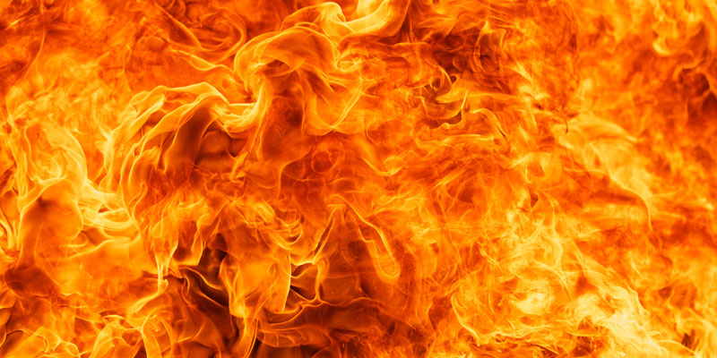
FIRE
FIRE IS CHEMICAL CHAIN REACTION BETWEEN FEUL HEAT AND OXYGEN

Slide 19
CLASSIFICATION OF FIRE
 | DESCRIPTION | EXAMPLE
A (SOLIDS) | FIRE INVOLVING ORDINORY COMPUSTABLE MATERIALS | WOOD, PAPER, TEXTILES ETC..
B (LIQUIDS) | FIRE INVOLVING FLAMMABLE LIQUIDS OR LIQUEFIABLE SOLIDS | PETROLIUM PRODUCTS, PAINTS ETC..
C (GASES) | FIRE INVOLDING GASES OR LIQUEFIED GASES | LPG, H2S, H2 ETC..
D (METAL) | FIRE THAT OCCUR IN COMPASTIBLE METALS | SODIUM,ZINC, POTTASIUM, MG ETC..

Slide 20
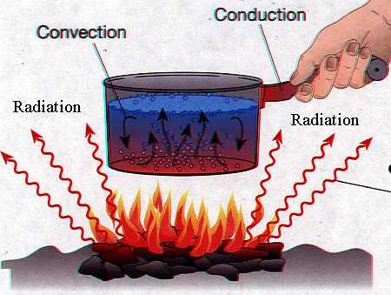
METHODS OF HEAT TRANSFER
CONDUCTION
HEAT TRANSFER THROUGH A MEDIUM OF SOLID BODY.
CONVECTION
HEAT TRANSFER THROUGH UPWORD MOTION OF HEATED MATTERS.
RADIATION
HEAT TRANSFER THROUGH AIR HEAT WAVE.

Slide 21
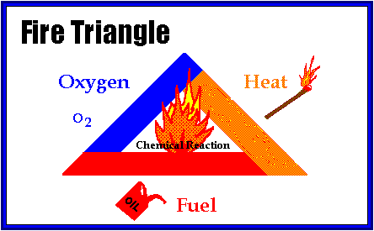
FIRE TRIANGLE

Slide 22
STAGES OF FIRE
INCIPIENT STAGE
SMOULDRING STAGE
FLAME STAGE
HEAT STAGE

Slide 23
STAGES OF FIRE
INCIPIENT STAGE
INVISIBLE PRODUCTS OF COMBUSTION GIVEN OFF, NO VISIBLE SMOKE, FLAAME OR HEAT.
SMOULDRING STAGE
COMBUSTION PRODUCTS NOW VISIBLE AS SMOKE. FLAME OR HEAT STILL NOT PRESENT.
FLAME STAGE
ACTUAL FIRE NOW EXITS
HEAT STAGE
UNCONTROLLED HEAT AND IT IS RAPIDLY EXPANDING IN SPACE

Slide 24
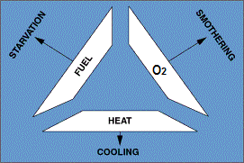
EXTINGUISHING METHODS

Slide 25
EXTINGUISHING METHODS
STARVATION
LIMITATION OR REMOVAL OF FUEL FROM THE SCENE OF FIRE IS KNOWN AS STARVATION
SMOTHERING
LIMITATION OR REMOVAL OF OXYGEN FROM THE SCENE OF FIRE IS KNOWN AS SMOTHERING
COOLING
LIMITATION OR REMOVAL OF HEAT FROM THE SCENE OF FIRE IS KNOWN AS COOLING

Slide 26
EXTINGUISHING METHODS
STARVATION …… TO REMOVAL OF FUEL
SMOTHERING ...... TO REMOVEL OF OXYGEN
COOLING ….. TO REMOVAL OF HEAT

Slide 27
EXTINGUISHING MEDIA
WATER
FOAM
DCP ( DRY CHEMICAL POWDER )
CO2
SAND

Slide 28
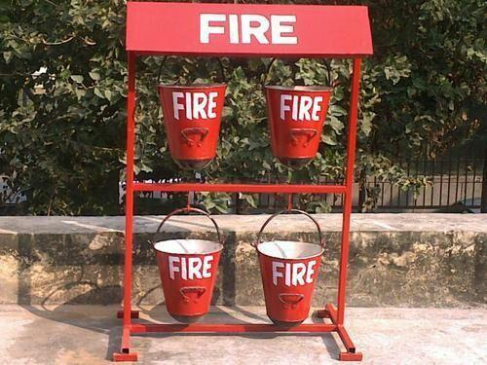
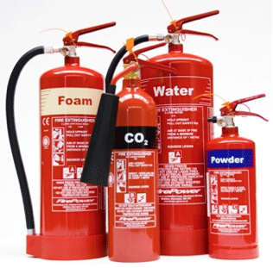

Slide 29
HOW TO USE FIRE EXTINGUISHER
IT IS EASY TO REMEMBER HOW TO USE A FIRE EXTINGUISHER IF U CAN REMEMBER A SHOT FORM PASS WHICH STANDS FOR PULL, AIM, SQUEEZE & SWEEP

Slide 30
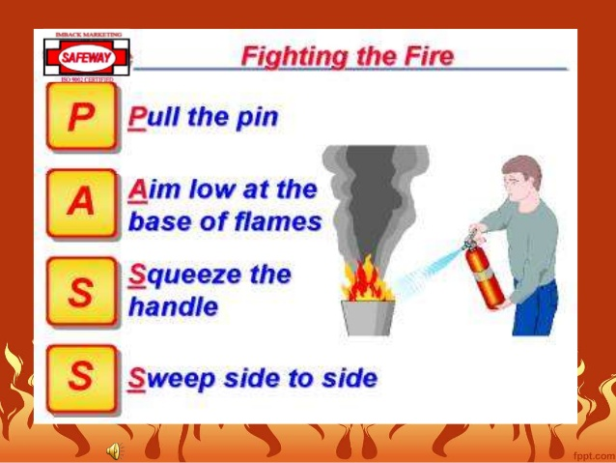

Slide 31
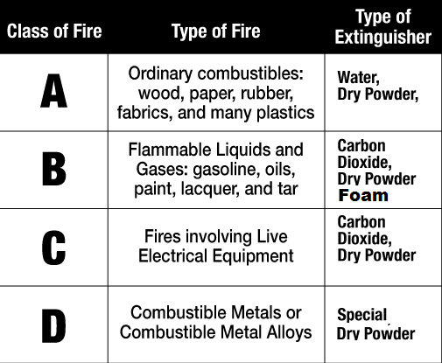
CLASSIFICATION OF FIRE EXTINGUISHER

Slide 32
PETROLEUM CLASSIFICATION
CLASS A ( LIQUIDS ) | FLASH BELOW 23*C | PETROL,LPG, ACETYLENE
CLASS B ( LIQUIDS ) | FLASH POINT BETWEEN 23*C & 65*C | KEROSENE
CLASS C ( LIQUIDS ) | FLASH POINT BETWEEN 65*C & 93*C | DIESEL OILS, FURNACE OIL
EXCLUDED PETROLEUM | FLASH POINT ABOVE 93

Slide 33
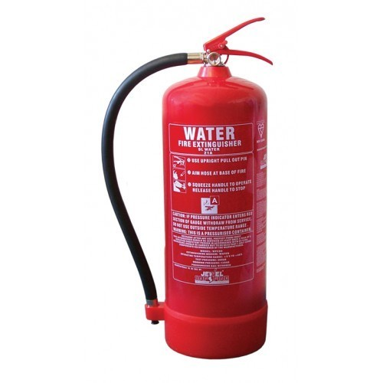
TYPES OF FIRE EXTINGUISHER
WATER

Slide 34
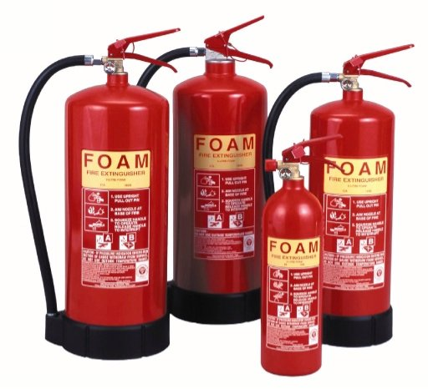
TYPES OF FIRE EXTINGUISHER
FOAM

Slide 35
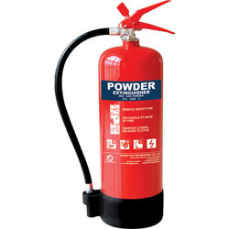
TYPES OF FIRE EXTINGUISHER
D - DRY
C - CHEMICAL
P - POWDER

Slide 36
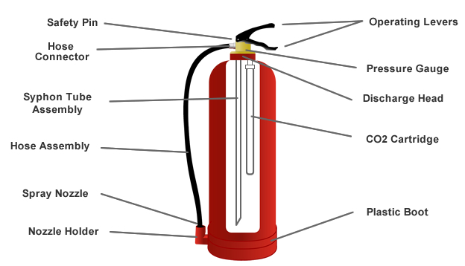
FIRE EXTINGUISHEN ANATOMY

Slide 37
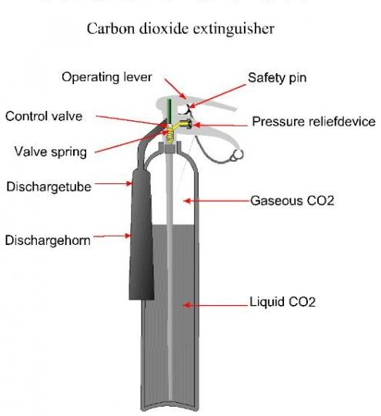
FIRE EXTINGUISHEN ANATOMY
CO2 TYPE

Slide 38

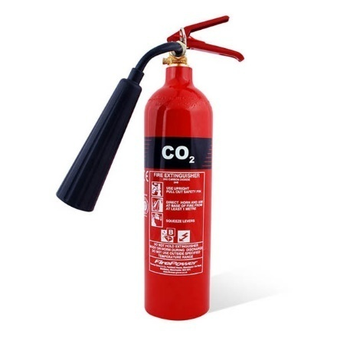
COLOUR OF EXTINGUISHER
WATER - RED
FOAM - CREAM
POWDER - BLUE
CARBON DIOXIDE - BLACK

Slide 39
TYPES OF EXTINGUISHERS
GAS CARTRIDGE.
THE PRESSURE IS PRODUCED BY MEANS OF COMPRESSED OR LIQUEFIED GAS RELEASED FROM A GAS CARTRIDGE FITTED IN TO THE EXTINGUISHER.
STORED PRESSURE
THE EXPELLANT GAS IS STORED WITH THE EXTINGUISHING MEDIUM IN THE BODY OF THE EXTINGUISHER, WHICH IS THE PERMANENTIY PRESSURIZED.

Slide 40
ADVANTAGES OF DCP
HARMLESS TO SKIN
NON-CONDUCTOR OF ELECTRICITY
GOOD FOR BLAST FIRE
BETTER THAN CO2 ON LIQUID FIRE
NON TOXIC AND NON CORRSOIVE

Slide 41
DISADVANTAGES OF DCP
DCP CANNOT BE USED ON METAL FIRE LIKE SODIUM, MAGNESIUM ETC….
DCP CANNOT BE USED TO PRODUCE INERT ATMOSPHERE TO PREVENT GAS/VAPOUR

Slide 42
FIRE EXTINGUISHER CHECKLIST
SI.NO | LOCATI-ON | TYPE | PRESSER GUAGE | SAFETY PIN | DUE DATE | OUTER CYLINDER | HOSE NOZZLE | RE-MARK
1 | GLOBAL MVPA | ABC |  |  | 10/17
2 | GLOBAL MVPA | CO2 |  |  | 10/17

Slide 43
DEFINITIONS
ACCIDENTS
AN ACCIDENT IS UN DESIGNED AND UN PLANED EVENT THAT RESULT IN PERSONAL INJURY OR PROPERTY DAMAGE OR ENVIRONMENTAL POLLUTION.
INJURY
INJURY CAN BE DEFINED AS HARMFUL CONDITION SUSTAINED BY THE BODY RESULT OF AN ACCIDENT.
HAZARD
A SITUATION WITH THE POTENTIAL TO CAUSE HARM IN HAZARD

Slide 44
DEFINITIONS
RISK
IT IS THE PROBABILITY OF THE REALIZATION OF THE POTENTIAL FOR LOSS
NEARMISS
AN UNPLANED AND UNDESIGHNED EVENT THAT HAD THE POTENTIAL TO LEAD TO INJURY DAMAGE OR LOSS.
TOOL BOX TALK
TOOL BOX TALK IS A PRE-JOB MEETING IN WHICH THE SUPERVISOR,SAFETY OFFICER CONCERNED WILL EXPLAIN TO THE WORKERS ABOUT THE JOB AND THE HAZARD.

Slide 45
DEFINITIONS
WHO IS A COMPETENT PERSON ???
IS ONE WHO IS PROPERLY TRAINED AND AUTHORIZED TO PERFORM A SPECIFIC WORK IN A SAFE MANNER.

Slide 46

STANDARED SAFETY SIGNAGE
MANDATORY- BLUE & WHITE

Slide 47

STANDARED SAFETY SIGNAGE
PROHIBITION – RED & BLACK

Slide 48
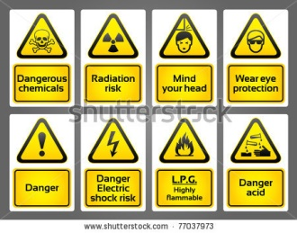
STANDARED SAFETY SIGNAGE
WARNING- YELLOW & BLACK

Slide 49
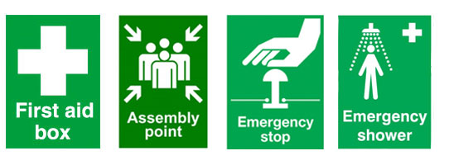
STANDARED SAFETY SIGNAGE
SAFE CONDITION- GREEN & WHITE

Slide 50

STANDARED SAFETY SIGNAGE
FIRE EQUIPMENTS

Slide 51
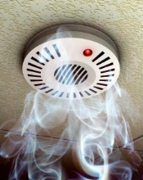
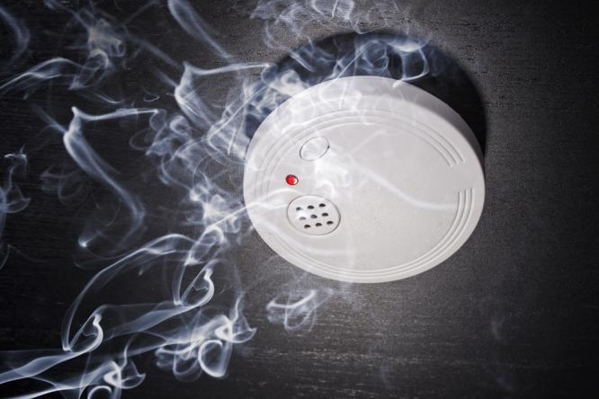
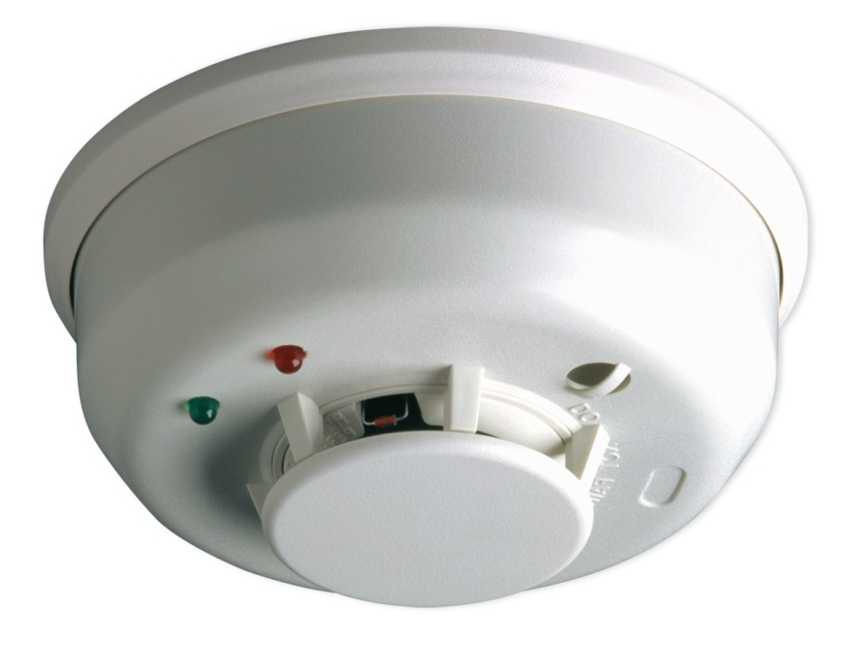
FIRE DETECTORS
SMOKE DETECTOR

Slide 52
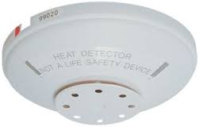
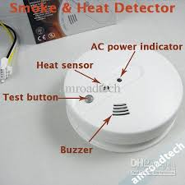
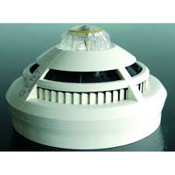
FIRE DETECTORS
HEAT DETECTORS

Slide 53
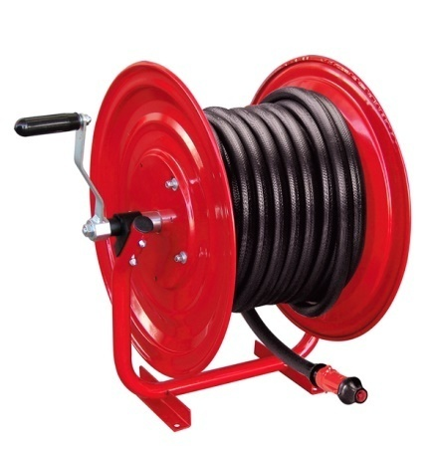
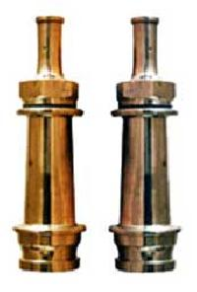
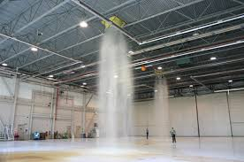
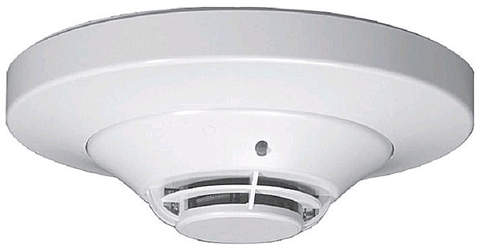
FIRE FIGHTING EQUIPMENTS
FIRE BLANKETS
HOSE REELS
FIRE FIGHTING HOSE
FIRE MONITOR
FIRE HYDRENT
SPRINKLER SYSTEM

Slide 54
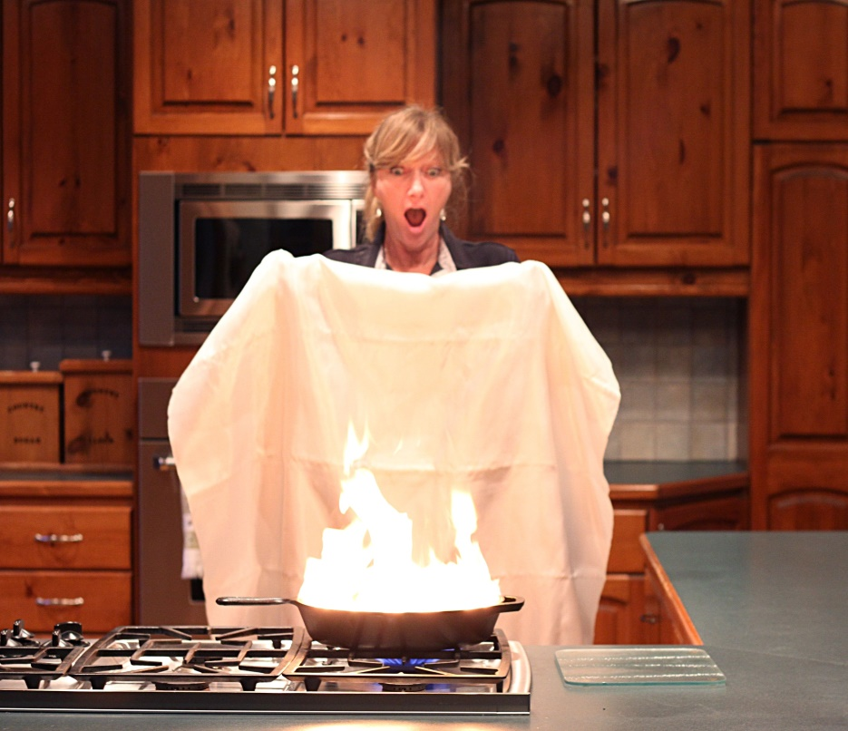
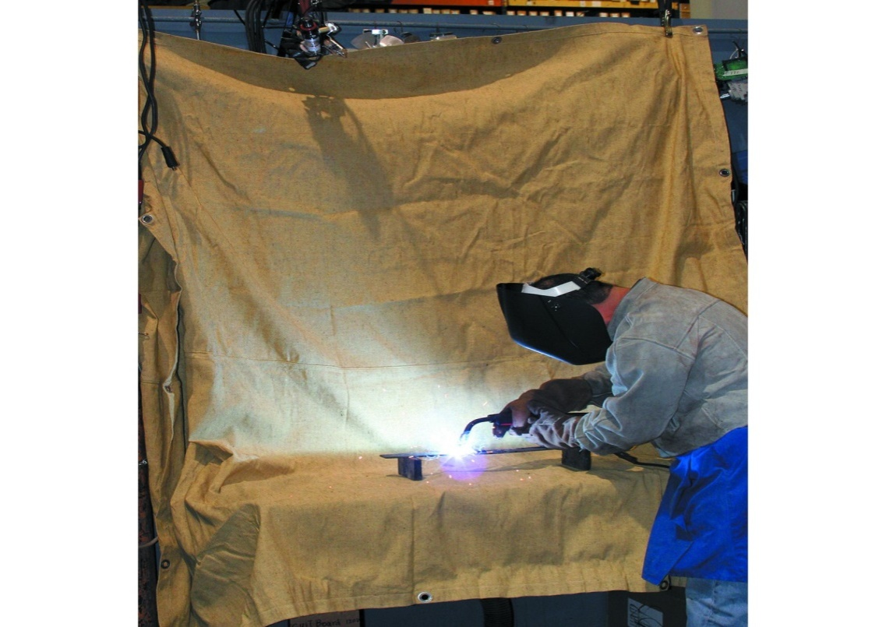
FIRE FIGHTING EQUIPMENTS
FIRE BLANKETS

Slide 55
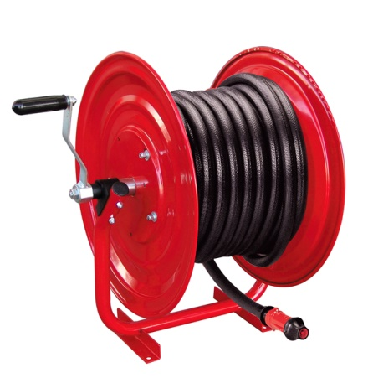
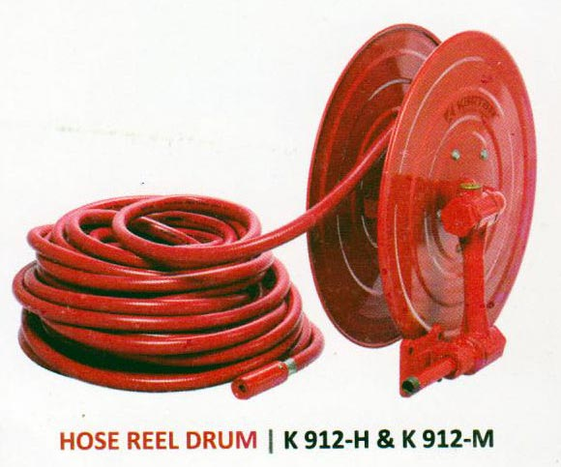
FIRE FIGHTING EQUIPMENTS
HOSE REELS

Slide 56
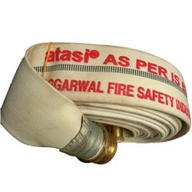
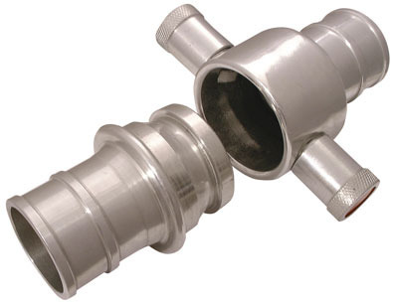
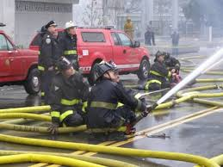
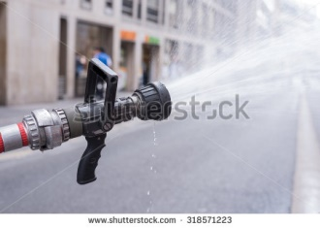
FIRE FIGHTING EQUIPMENTS
FIRE FIGHTING HOSE

Slide 57
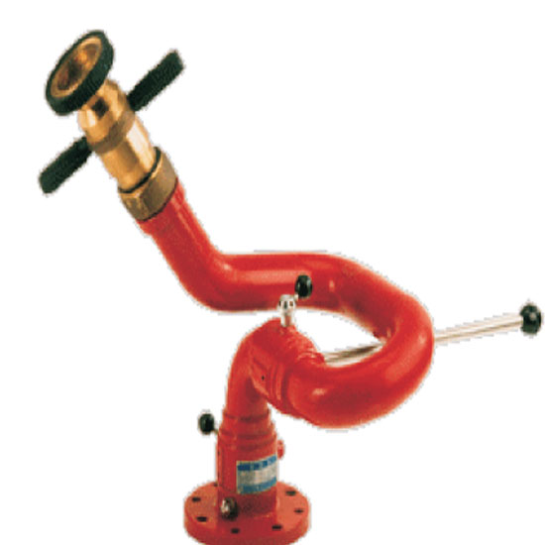
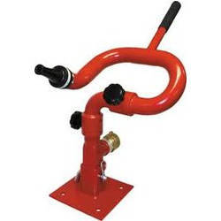
FIRE FIGHTING EQUIPMENTS
FIRE MONITOR

Slide 58
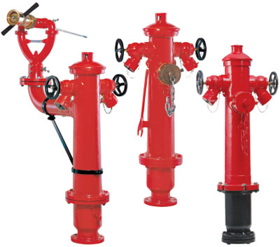
FIRE FIGHTING EQUIPMENTS
FIRE HYDRENT

Slide 59
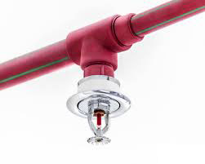
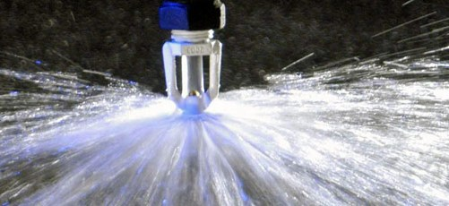
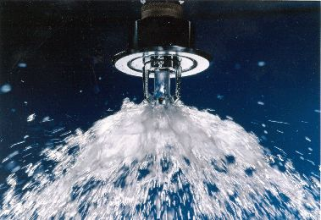
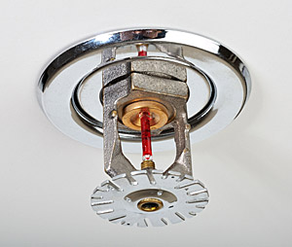
FIRE FIGHTING EQUIPMENTS
SPRINKLER SYSTEM

Slide 60
COMMON CAUSES OF FIRE
SPARK FROM ELECTICITY
SMOKING
HOT WORK
NAKED FLAME
HOT SURFACE
SPARK FROM VEHICLES
LIGHTINING
STATIC ELECRTICITY

Slide 61
CONSEQUENCE OF FIRE
PEOPLE KILLED AND INJURED
DAMAGE TO BUILDING
ENVIRONMENT DAMAGE

Slide 62
DEFINITIONS
FLASH POINT
THE LOWEST TEMPERATURE AT WHICH THE COMBASTIBLE MATERIAL GIVE SUFFICENT VAPOUR TO START AN IGNITION.
FIRE POINT
THE LOWEST TEMPRATURE AT WHICH THE COMBASTIBLE MATERIAL GIVE SUFFIIENT VAPOUR TO CONTINEUS THE COMBUSTION.
IGNITION TEMPREATURE
THE LOWEST TEMPERATURE AT WHICH IT WILL SPONTANEOUSLY IGNITE IN A NORMAL WITH OUT AN EXTERNAL SOURCE OF IGNITION.

Slide 63
DEFINITIONS
LEL- LOWER EXPLOSIVE LIMIT
THE LOWEST CONCENTRATION AT WHICH A FUEL MIXTURE WILL BURN.
UEL- UPPER EXPLOSIVE LIMIT
THE HIGHEST CONCENTRATION AT WHICH A FUEL MIXTURE WILL BURN.

Slide 64
P- PERSONAL P- PROTECTIVE E- EQUIPMENT GLOBAL SAFETY STUDIES

Slide 65
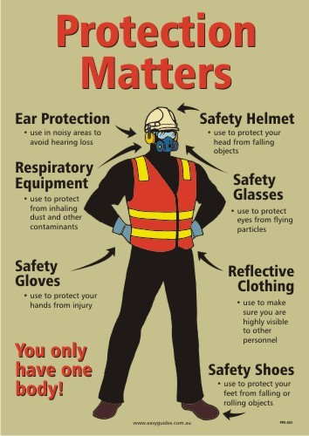
PPES

Slide 66
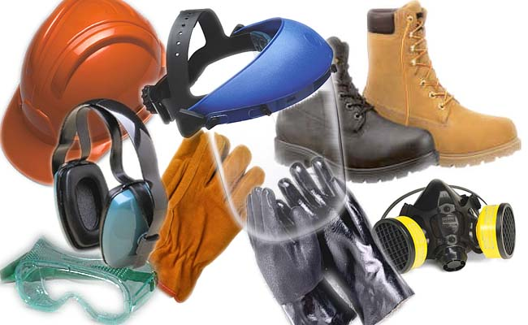
PERSONAL PROTECTIVE EQUIPMENT
PERSONAL PROTECTIVE EQUIPMENT A VARIETY OF DEVICE,TO PROTECTE EMPLOYEES FROM INJURY.

Slide 67
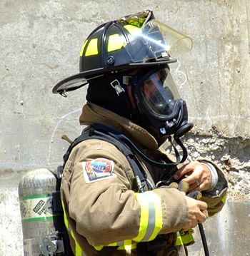
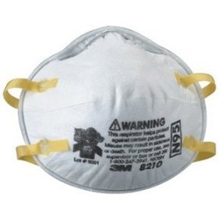
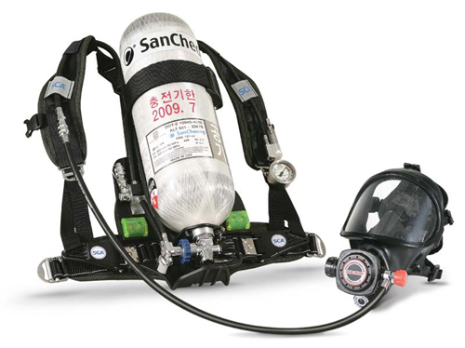
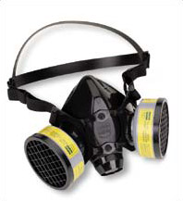
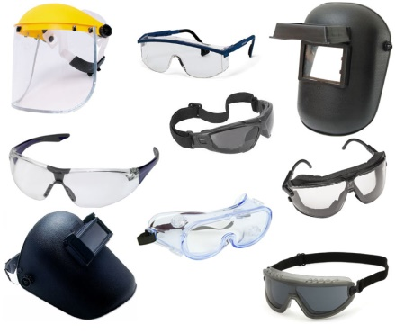
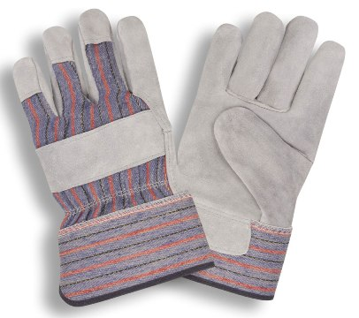
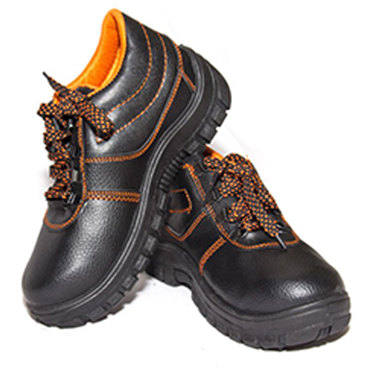

TYPES OF PPES
RESPIRATORY PROTECTIVE EQUIPMENTS
Eg; SCBA, AIR RESPIRATORS ETC..
NON- RESPIRATORY PROTECTIVE EQUIPMENTS
Eg; HARD HAT, GLOVES, GOGGLES, SAFETY SHOES ETC..

Slide 68
NON-RESPIRATORY PROTECTIVE EQUIPMENTS
COMMON PPES
HEAD PROTECTION
EYE & FACE PROTECTION
HAND PROTECTION
FOOT PROTECTION

Slide 69


HEAD PROTECTION
PREVENTION OF HEAD INJURES IS AN IMPORTANT FACTOR IN EVERY PROGRAM, HEAD INJURY ARE CAUSED BY FALLING, FLYING OBJECT OR BY JUMBING THE HEAD AGAINST A FIXED OBJECT..

Slide 70


HEAD PROTECTION
HEAD INJURIES

Slide 71


EYE & FACE PROTECTION
SUTABLE EYE PROTECTOR MUST BE PROVIDE, WHEN THERE IS A POTENTIAL FOR FACE FROM FLYING PURTICLE, LIQUIDS, CHEMICALS, CHEMICAL GAS, VAPOURS, POTTENTIALLY INJURIOUS LIGHT RADIATION OR COMBINATION OF THESE.

Slide 72
TYPES OF EYE & FACE PROTECTION
SAFETY GLASSES
SAFETY GOGGLES
FACE SHIELDS
WELDING GOGGLES
LASER SAFETY GLASS

Slide 73



EYE & FACE PROTECTION

Slide 74


FOOT PROTECTION
FOR PROTECTION FEET AND LEGS FROM FALLING OBJECTS, SHARP OBJECTS, HOT SURFACE AND WET SURFACE.
SAFETY SHOES SHOULD BE STURDY AND HAVE RESISTANT TOE
SOME SHOE METAL INSOLE PROTECTE AGAINST PUNCTURE WOUNDS

Slide 75


FOOT PROTECTION

Slide 76


HAND PROTECTION
WHEN MUST HAND PROTECTION BE PROVIDE BURNS, ABRASION, CUTS, PUNCTURES, BRUISE, CHEMICAL EXPOSURE..

Slide 77


HAND PROTECTION

Slide 78





TYPES OF GLOVES
LEATHER GLOVES
COTTEN GLOVES
CHEMICAL PROTECTION GLOVES
INSULATED RUBBER GLOVES
WELDING GLOVES

Slide 79



EAR PROTECTION
HEARING PROTECTION SHALL BE MADE AVAILABLE AND SHALL BE WORN BY ALL EMPLOYEES EXPLOSSED TO AN 8 HOUR OF 85 DB OR GREATER
EAR MUFF
EAR PLUG

Slide 80


HEARING PROTECTORS
EAR PLUGS - PREFERRED ( 20-30 DB )
EAR MUFFS – 2ND CHOICE ( 15-30 DB )
DOUBLE HEARING PROTECTORES ( PLUG & MUFF )-
( 30-40 DB ) USED FOR LEVELS OVER 115 DB

Slide 81

NOICE LEVELS
MEASURED IN DECIBELES ( DB )
* WHISPER - 10-20 DB
* SPEECH - 60 DB
* NOISY OFFICE - 80 DB
* PASSING TRUCK - 100 DB
* JET ENGINE – 150 DB
OSHA LIMIT – 85 DB

Slide 82
PERMISSIBLE EXPOSURE LIMIT – PEL
PERMISSIBLE NOISE EXPOSURE
DURTION PER DAY ( HOURS ) | SOUND LEVEL ( DB )
8 HOURS | 90 DB
4 HOURS | 95 DB
2 HOURS | 100 DB
1 HOURS | 105 DB
½ HOURS | 110 DB
¼ HOURS | 115 DB

Slide 83
RESPIRATORY PROTECTIVE EQUIPMENTS
RESPIRATORY PROTECTIVE EQUIPMENTS ARE LIFE SAVING EQUIPMENTS

Slide 84
TYPES OF PROTECTIVE DEVICES
AIR PURIFYING DEVICES
AIR SUPPLYING DEVICES
COMBINATION OF AIR PURIFYING AND AIR SUPPLYING DEVICES

Slide 85

AIR PURIFYING DEVICES
THE AIR PURIFYING DEVICES CLEANS THE CONTAMINATED ATMOSPHERE.
THE VARIOUS TYPES OF AIR PURIFYING DEVICE
* MECHANICAL FILTTERS CARTRIDGE
* CHEMICAL CARTRIDGE
* GAS MASC
* POWDERED AIR PURIFYING DEVICES

Slide 86

AIR PURIFYING DEVICES

Slide 87

AIR SUPPLYING DEVICES
AIR SUPPLYING DEVICES ARE THE CLASS OF RESPIRATORS THAT PROVIDE A RESPIRABLE ATMOSPHERE TO THE WEARER, INDIPENDENT OF THE AMBIENT AIR.
TYPES OF AIR SUPPLYING DEVICES
SELF CONTAINED BREATHING APPARATUS ( SCBA )
COMPRESSED AIR BREATHING APPARUTUS ( CABA )
EMERGENCY ESCAPING BREATHING APPARATUS

Slide 88

BRATHING APPARUTUS ANATOMY

Slide 89
SAFETY INSPECTION
DEFINITION ;
IT IS TO INVOLVE IDENTIFICATION OF OBVIOUS VISIBLE HAZARDS WITH THE OBJECTIVE OF ELIMINATING OR CONTROLE THE HAZARD THAT HAVE BEEN IDENTIFIED.
DURING A SITE SAFETY INSPECTION
HOUSE KEEPING
SAFETY SIGHN BOARD
WELFARE FACILITY
FENSING & SECURITY
STORES & STORAGE
FIRE EXTINGUISHER

Slide 90
FIRE PROCEDURES
FIRST AID FACILITY
PPES
BARRICADING
SCAFFOLDING & WORKING PLATFORM
LADDER
CRANES & LIFTING EQUIPMENTS
EXCAVATION
CONFINED SPACE
ELECTRICITY
OVER HEAD & UNDER GROUND SERVICES
ELECTRICAL EQUIPMENT & HAND TOOL
WELDING EQUIPMENTS
SUBSTANCES HAZARDOUS TO HEALTH
OTHER HAZARDS

Slide 91

HOUSE KEEPING
GLOBAL SAFETY STUDIES

Slide 92
HOUSE KEEPING
DEFINITION
A PLACE FOR EVERY THING AND EVERY THING IN ITS PROPER PLACE.
GOOD HOUSE KEEPING IN THE KEY TO SAFETY.
HOUSE KEEPING IS EVERY ONE’S RESPONSIBILITY.

Slide 93

HOUSE KEEPING
BENEFITS OF HOUSE KEEPING
GOOD HOUSE KEEPING PREVENTING ACCIDENTS AND INJURIES.
GOOD HOUSE KEEPING SAVE SAPCE,TIME AND MATERIALS.
WHEN A WORK PLACE IS CLEAN WORKERS FEEL BETTER, THINK BEETER, AND DO BETTER.
GOOD IMPRESSION WITH VISITORS
FIRE HAZARD ELIMINATION
MORE EFFITIVE USE OF SPACE

Slide 94


HOUSE KEEPING
ACCIDENTS OF POOR HOUSE KEEPING
TRIPPING OVER LOOSE OBJECTS ON FLOORS,STAIRS AND PLATFORMS
BEING HIT BY FALLING OBJECTS
SLIPPING ON GREASY, WET OR DIRTY SURFACE
WASTE CONTAINER OVER FLOWING
TOOLS LEFT ON MACHINES

Slide 95



HOUSE KEEPING
INJURIES FROM SLIPS, TRIPS, AND FALLS.
BROKEN BONES
BACK OR SPINE INJURY
STAINS/ SPRAINS
DEATH

Slide 96
HOUSE KEEPING
GOOD HOUSE KEEPING
GOOD HOUSE KEEPING PREVENTING ACCIDENTS AND INJURIES.
ALL MATERIAL SHOULD BE PROPERLY STORED
KEEP BOLTS, NUTS, ETC… IN A TRAY/ BUCKET
PIPES, SCAFFOLD MATERISLS,ETC… ARE POTENTIAL TRIP HAZARD. DON’T STORE IN WALKWAY
DON’T STORE MATERIALS ON WORKING PLATFORM AND NEAR ACCESS LADDER/STAIR
DON’T ROUTE CABLES & HOSES THROUGH STAIRCASE / LADDER POSING POTENTIAL TRIP HAZARD
DON’T DRAIN STICKY MATERIAL/OIL ON FLOOR POSING SLIP HAZARD AND FALL HAZARD

Slide 97

HOUSE KEEPING
DON’T USE FIRE WATER FOR CLEANING
DON’T BLOCK ACCESS TO FIRE AND EMERGENCY EQUIPMENTS
ALL MATERIAL SHOULD BE PROPERLY STORED

Slide 98
HOUSE KEEPING
GOOD HOUSE KEEPING CHECKLIST
WALLS CLEANS
WINDOW CLEANS
PROPER LIGHT PROVIED
PLATFORM IN GOOD CONDITION
STAIRS CLEAN AND WET
FREE OIL, GREASE ETC…
SAFE AND FREE ACCESS TO WORK POSITION
EMPLOYEES FACILITIES
WASTE DISPOSAL
STORAGE
TOOLS AND EQUIPMENTS

Slide 99

HOUSE KEEPING
WHAT IS YOUR FAVORITE PLACE TO WORK ?

Slide 100


HOUSE KEEPING
BAD HOUSEKEEPING

Slide 101
HOUSE KEEPING
GOOD HOUSE KEEPING

Slide 102





HOUSE KEEPING
BAD HOUSE KEEPING

Slide 103

ENVIRONMENT
GLOBAL SAFETU STUDIES

Slide 104

ENVIRONMENT
DEFINITION
ENVIRONMENT MEANS THE SURROUNDING IN WHICH AS ORGANIZATION OPERATE INCLUDING AIR, WATER, LAND, NATURAL RESOURES, FLORA HUMAN AND THEIR INTER RELTIONSHIP.

Slide 105



ENVIRONMENT
TYPES OF POLLUTION
AIR POLLUTION
WATER POLLUTION
SOIL POLLUTION

Slide 106



ENVIRONMENT
EFFECTS OF POLLUTION
REDUCED LUNG FUNCTIONING
IRRITATION OF EYES, NOSE, AND MOUTH
ASTHMA ATTACK
RESPIRATORY DISEASE
REDUCE ENERGY LEVEL
HEAD ACHE
MENTAL DISORDER
CANCER
DEATH

Slide 107
ENVIRONMENT
HOW TO SAVE ENVIRONMENT
DO NOT WASTE WATER
PREVENT POLLUTION ON THE GROUND, AIR, AND WATER BY AVIODING ANY CHEMICAL SPILLS
ENSURE ALL WASTE IS COLLECTED AND PLACED IN TO THE SPECFIC CONTAINERS
USE TOILET FACILITIES
DO NOT BURN WASTE
DO NOT KILL ANY WILD
REPORT ANY CHEMICAL SPILLS
SITE VEHICLE TO HAVE SPILL KITS
STORE CHEMICAL ONLY IN THE APPROVED STORAGE AREA WHERE SPILL KIT ARE AVAILABLE

Slide 108
WASTE MANAGEMENT
WHAT IS WASTE MANAGEMENT ???..
WASTE MANAGEMENT MEANS SAFETY DISPOSING THE BY- PRODUCT OF A PROCESS OR A WORK TO THE ENVIRONMENT ( AFTER PROPER TREATMENT, IF NECESSARY) SO THAT NO THREAT FOR LIVINGS, PROPERTIES AND ENVIRONMENT EXISTS.

Slide 109





WASTE DISPOSAL
CLASSIFICATION OF WASTE
HAZARDOUS WASTE
NON- HAZARDOUS WASTE

Slide 110





WASTE DISPOSAL
HAZARDOUS WASTE
HIGHLY FLAMMABLE WASTE
CHEMICAL WASTE
TOXIC WASTE
CORROSIVE WASTE
ELECTRONIC WASTE
Etc….

Slide 111



WASTE DISPOSAL
NON- HAZARDOUS WASTE
HOUSE WASTE
FOOD WASTE
PAPER
WOOD
COTTON
Etc…

Slide 112



WASTE DISPOSAL
SEGREGATION
WASTE TYPES MUST BE SEGREGATED TO PREVENT THE MIXING AND CONTAMINATION OF ONE TYPE OF WASTE WITH ANOTHER. THIS USUALLY REQUIRES SEPARATE SECURE STORAGE FOR EACH TYPE WASTE AND THE CLEAR IDENTFICATION OF TYPES.

Slide 113



MOVEMENTS OF PEOPLE
SLIP & TRIP
CAUSE- SLIP HAZARD
SMOOTH FLOOR SARFACE
WET
CONTAMINATION OIL
FROST AND ICE

Slide 114



MOVEMENTS OF PEOPLE
CAUSE- TRIP HAZARD
UNEVEN OR LOOS FLOOR SURFACE
TRAILING CABLES
OBJECT AT FLOOR

Slide 115




MOVEMENTS OF PEOPLE
CONTROL MESURESS
RISK ASSESSMENT
MANTANCE OF MECHINARY
SLIP RESISTANCE SURFACE , SPILLAGE CONTROL FOR SURFACE
GOOD HOUSE KEEPING
USE SINGH FOR PPE’S
LAY CABLES
DESIGNTED WALK WAYS

Slide 116


MAIN CAUSES OF ACCIDENT
ACCIDENTS
AN ACCIDENT IS UN DESIGNED AND UN PLANED EVENT THAT RESULT IN PERSONAL INJURY OR PROPERTY DAMAGE OR ENVIRONMENTAL POLLUTION.
UNSAFE ACTION
UN SAFE CONDITION

Slide 117
UNSAFE ACTION
DEFINITION
THESE ARE WHERE THE ACTION OF THE PEOPLE IN THE WORK PLACE DIRECTLY CAUSE OR CONTRIBUTE TO THE INCIDENT.
USE WRONG TOOLS
ARRANGING OR PLACEING OBJECT UNSAFELY
USING EQUIPMENTS UNSAFELY
OPERATING WITHOUT PERMITION

Slide 118
UNSAFE ACTION
WORKING AT UNSAFE SPEED
USING DEFECTIVE EQUIPMENT & TOOLS
FAILURE TO USE OF PPE
IMPROPER LIGHTING
SMOKING
HORSE PLAY
NOT USING SAFETY DEVICES
NOT REPORTING SAFETY PROBLEMS
WORKING UNDER THE INFLUENCE OF ALCOHOL

Slide 119





UNSAFE ACTION

Slide 120
UNSAFE CONDITION
DEFINITION
THESE ARE WHERE THE PHYSICAL CONDITION AT THE WORK PLACE, OR THE METHODS OF WORK, DIRECTLY CAUSE OR CONTRIBUTE TO THE INCIDENT.
INADEQUATE GUARDING
DEFECTIVE TOOLS
INADEQUATE VENTILATION
EXCESSIVE NOICE

Slide 121
UN SAFE CONDITION
NO PERSONAL PROTECTIVE EQUIPMENTS
WET AND SLIPPRY SURFACE
BAD HOUSEKEEPING
UNSAFE LIFTING
UNSAFE EQUIPMENTS
UNSAFE SYSTEM OF WORK
UNSAFE ENVIRONMENTL CONDITIONS

Slide 122





UN SAFE CONDITION

Slide 123
DOMINO THEORY
88% OF ACCIDENTS DUE TO UNSAFE ACTS.
10% OF ACCIDENTS DUE TO UNSAFE CONDITIONS.
2% ARE UNAVOIDABLE ACCIDENTS.

Slide 124

ELECTRICAL SAFETY
GLOBAL SAFETY STUDIES

Slide 125
ELECTRICAL SAFETY
ELECTRICITY
THE FLOW OF THE ELECTRON THROUGH A CONDUCTOR IN A CLOSED CERCUTE. THE FLOW THROUGH THE CONDUCTOR THRER MUST BE A POWER SOUECE.

Slide 126
ELECTRICAL SAFETY
ELECTRICAL HAZARD
PRIMARY HAZARD
SECONDARY HAZARD

Slide 127



PRIMARY HAZARD
ELECTRIC SHOCK
ELECTRIC BURN
ELECTRIC FIRE & EXPLOSION
ELECTRIC FLASH

Slide 128
SECONDARY HAZARD
PERSON FALL FROM HEIGHT
LOSE OF INFORMATION
DROPPING OF TOOL AND OBJETS
UN EXPECTED MOVEMENTS OF MACHINERY
HEALTH HAZARD DUE TO RELEASE TOXIC GAS & PRODUCTION OF UV RAYS
ENVIRONMENTAL HAZARD

Slide 129
ELECTRICAL SAFETY
EFFECTS OF ELECTRICAL SHOCK
DAMAGE TO NERVOUS SYSTEM
IRREGULAR HART BEAT
INTERNAL BURNS
STOP BREATHING
SKIN SURFACE BURN

Slide 130
ELECTRICAL SAFETY
MAJOR CAUSE OF ELECTRICAL FIRE
OVERLOADING OF CERCUTE
OCTOPUS
IMPROPERLY RATE CERCUTE
POOR DAMAGE INSULATION
POOR CONNECTION
FLAMMABLE MATERIALS

Slide 131
ELECTRICAL SAFETY
ELECTRICITY PROTECTION DEVICES
FUCES
EARTHING
ISOLATION
ELCB
MCB

Slide 132
SAFETY ARRANGEMENTS
PROPER INSPECTION
PROPER DISTRIBUTION BOARD TO BE PROVIDED IN DIFFERENT AREA
ALL CAABLE JOINTS SHALL BE MADE WITH INDUSTRIAL PLUG
GENERATOR SHOULD BE GROUNDED
USE PROPER PPE
GENERATOR AREA TO BE CLEANED PROPERLY
NO FLAMMABLE NEAR DG
PROVIDE EXTINGUISHER, SIGN BOARD AND BARRICATION AROUND THE DG
NO CABLE ARE NOT TO BE LAID ON WET AREA

Slide 133




ELECTRICAL SAFETY
INDUSTRIAL PLUG.

Slide 134
ELECTRICAL SAFETY
EMERGENCY ACTION
DON’T TOUCH THE CASUALTY
CALL FOR HELP
ISOLATE FROM THE POWER SUPPLY
CALL FOR AMBULANCE
CHECK FOR BREATHING
TREAT BURNS
TREAT FOR PHYSICAL SHOCK
ENSHORE MEDICAL

Slide 135

LOTO- (LOCK OUT TAG OUT)
GLOBAL SAFETY STUDIES

Slide 136

LOTO
DEFINITION
LOCKOUT MEANS TO PHYSICALLY NETURALIZE ALL ENERGIES IN A PIECE OF EQUIPMENT BEFORE BEGINNING ANY MAINTENANCE OR REPAIR WORK. LOCK OUT GENERALLY INVOLVE , STOPPING ALL ENERGY FLOWS AND PROVIDE A TAG TO HELP CONTROL MECHANICAL AND ELECTRICAL ISOLATION PROCEDURES.

Slide 137

LOTO- COLOUR CODE
ELECTRICAL DEPT; - RED
MECHANICAL DEPT; - YELLOW
INSTRUMENTATION DEPT - BLUE

Slide 138








LOTO
DIFFERENT TYPES OF LOCKS

Slide 139


ISOLATION
CUT OFF THE SPACE FROM ELECTRICAL SOURCES, ROTATING PARTS, HAZAEDOUS MATERIALS Etc….

Slide 140

SCAFFOLDNG
GLOBAL SAFETY STUDIES

Slide 141
SCAFFOLDNG
DEFINITION
SCAFFOLDING IS A TEMPORARY ELEVATED PLATFORM MADE FOR SAFELY WORKING AT HEIGHT.
INTRODUCTION
IT IS ESTIMATED THAT 2.3 MILLION CONSTRUCTION WORKERS DEAL WITH SCAFFOLDIG EATCH YEAR. MORE THAN 10000 WORKERS ARE INJURED AND 80 ARE KILLED IN SCAFFOLDING RELATED ACCIDENTS.

Slide 142
TYPES OF SCAFFOLDS
FRAME SCAFFOLDING
TUBE AND CLAMP
MODULAR SYSTEM SCAFFOLDS
ROLLING SCAFFOLDING (MOBILE SCAFFOLDS)
SUSPENDED SCAFFOLDIND

Slide 143


TYPES OF SCAFFOLDS
FRAME SCAFFOLDING

Slide 144


TYPES OF SCAFFOLDS
TUBE AND CLAMP

Slide 145



TYPES OF SCAFFOLDS
MODULAR SYSTEM SCAFFOLDS

Slide 146


TYPES OF SCAFFOLDS
ROLLING SCAFFOLDING (MOBILE SCAFFOLDING)

Slide 147


TYPES OF SCAFFOLDS
SUSPENDED SCAFFOLDIND

Slide 148
TYPES OF SCAFFOLDING ( BASED ON WORKING LOAD)
LIGHT DUTY SCAFFOLD
MEDIUM DUTY SCAFFOLD
HEAVY DUTY SCAFFOLD
SPECIAL DUTY SCAFFOLD

Slide 149

LIGHT DUTY SCAFFOLD
A SCAFFOLD DESIGNED AND CONSTRUCTED TO CARRY A WORKING LOAD NOT TO EXCEED 150kg/ M2

Slide 150

MEDIUM DUTY SCAFFOLD
A SCAFFOLD DESIGNED AND CONSTRUCTION TO CARRY A WORKING LOAD NOT TO EXCEED 200 kg/M2

Slide 151

HEAVY DUTY SCAFFOLD
A SCAFFOLD DESIGNED AND CONSTRUCTED TO CARRY A WORKING LOAD NOT TO EXCEED 250kg/M2

Slide 152

SPECIAL DUTY SCAFFOLD
SCAFFOLD DESIGNED AND CONSTRUCTED TO CARRY SPECIFIC TYPE OF OBJECTS

Slide 153




COMMON PARTS OF SCAFFOLD
SOLE BOARD/ SILLS
BASE PLATE
STANDARD/ POST
LEDGER
BRACE
TRANSOM
COUPLER
WORKING PLATFORM
GUARD RAILS
ACCESS LADDER

Slide 154


COMMON PARTS OF SCAFFOLD
SOLE BOARD/SILLS
SILVER OAK WOODEN PLANK SUPPORRT BASE PLATE AT GROUND.

Slide 155

COMMON PARTS OF SCAFFOLD
BASE PLATE
IT IS A MILD STEEL SQUARE-PLATE

Slide 156

COMMON PARTS OF SCAFFOLD
STANDARD/POST
IT IS VERTICAL SCAFFOLD TUBE

Slide 157

COMMON PARTS OF SCAFFOLD
LEDGER
IT IS HORIZONTAL SCAFFOLD TUBE

Slide 158


COMMON PARTS OF SCAFFOLD
BRACE
A TUBE PLACED TO THE VERTICAL AND HORIZONTAL MEMBERS OF A SCAFFOLD AND FIXED TO THEM TO GIVE STABILITY.

Slide 159


COMMON PARTS OF SCAFFOLD
TRANSOM
TUBES FIXED AT RIGHT ANGLE ACROSS THE LEDGERS, ADJACENT TO EATCH PAIR OF STANDAEDS TO SUPPORT THE SCAFFOLD BOARDS

Slide 160

COMMON PARTS OF SCAFFOLD
COUPLER
A DEVICE FOR LOCKING TOGETHER COMPONENT PARTS OF TUBE AND COUPLER SCAFFOLD .

Slide 161







COUPLER
TYPES OF COUPLERS

Slide 162


COMMON PARTS OF SCAFFOLD
WORKING PLATFORM
AN ELEVATED WORK SURFACE COMPOSED OF ONE OR MORE PLATFORM UNITS.

Slide 163


COMMON PARTS OF SCAFFOLD
GUARD RAILS
TOP RAIL
MID RAIL
TOE BOARD

Slide 164
COMMON PARTS OF SCAFFOLD
GUARD RAILS- HEIGHT
TOP RAIL
MID RAIL
TOE BOARD
 | 70 CM |  | TOTAL- 110 CM
 | 40 CM
 | 15 CM

Slide 165


LADDER
HAZARDS OF LADDERS
DON’T STAND LADDER ON DRUM, BOX OR OTHER UNSTABLE BASE
NEVER ATTEMPT TO REPAIR BROKEN LADDER
NEVER CARRY LOAD UP LADDER HOIST IT UP
WHEN USING THE METEL LADDER, , MAKE SURE THERE ARE NO ELECTRICAL HAZARD IN THE NEAR VICINITY
FALLING OFF THE LADDER

Slide 166


LADDER
SAFE LADDER PLACING
LADDER SHOULD BE SET AN ANGLE OF ABOUT 75 OR ONE METER FOR EVERY FOUR METER RISE

Slide 167
LADDER
LADDER-SAFETY
USE ONLY APPROVED LADDERS
INSPECT BEFORE USE
ONE PERSON ONLY
USE FALL ARREST IF > 6 FT WORKING FROM LADDER
EXTEND 3 FEET ABOVE ACCESS OR WORKING LEVEL
USE 4:1 LEAN RATIO
USE 3 POINT CONTACT

Slide 168

LADDER
LADDER SAFETY

Slide 169


LADDER
MONKEY LADDER

Slide 170
HAZARDS- SCAFFOLDING
FALL FROM SCAFFOLD DURING ERACTION
FALL FROM WORKING PLATFORM
ELECTROCUTION- FROM OVERHEAD POWER LINES
FALLING OBJECT
SCAFFOLD COLLAPSE

Slide 171
CAUSE OF SCAFFOLD COLLAPSE
OVER LOAD WORK PLATFORM
SOFT GROUND
NOT TIED IN PROPERLY
BRAZING INSAFFICENT
HIGH WIND
INCORRECT COUPLAR
SCAFFOLD ERECTED BY INCOMPETANT WORKERS
SCAFFOLD NOT INSPETED PRIOR TO USE

Slide 172
SAFETY ARRAGEMENTS -SCAFFOLD
USE APPROPRIATE SCAFFOLD CONSTRUCTION METHOD
PROPER INSPECTION
TRAINED AND CERTIFIED WORKER
NOT EXCEED SAFE LOAD
ERECTION ON A LEVEL GROUND
10 FEET SAFE DISTANCE FROM POWER LINE
PROPER FALL PROTECTION SYSTEM

Slide 173
SCAFFOLD FALL PROTECTION SYSTEM
GUARD RAIL
TOP RAIL
MID RAIL
TOE BOARD
TRAINING
BARRICATION
FULL BODY HARNESS
SAFETY NETS
SAFETY MONITORING
PFAS – PERSONAL FALL ARREST SYSTEM

Slide 174


SCAFFOLD FALL PROTECTION SYSTEM
FULL BODY HARNESS

Slide 175

FULL BODY HARNESS
PARTS OF HARNESS

Slide 176



SCAFFOLD FALL PROTECTION SYSTEM
SAFETY NETS

Slide 177
SCAFFOLD FALL PROTECTION SYSTEM
GUARD RAILS
TOP RAIL
MID RAIL
TOE BOARD

Slide 178
SCAFFOLD INSPECTION CHECK LIST
CHECK FOR MISSING PLANKS ON PLATFORM
CHECK FOR MISSING GUARD RAIL SYSTEM
CHECK FOR PROPER ACCESS
CHECK FOR HOUSE KEEPING ON SCAFFOLD PLATFORM (LOOSE MATERIALS, WORKING WASTE ETC…)
CHECK FOR PROPER TYING OFF BUILDING

Slide 179



SCAFF TAG SYSTEM
THREE TYPES OF SCAFF TAG
RED TAG – DON’T USE
GREEN TAG – OK TO USE
YELLOW TAG – CHECK WITH SUPERVISOR
IF THERE IS NO SCAFF TAG DON’T USE THE SCAFFOLD

Slide 180

WORK AT HEIGHT
GLOBAL SAFETY STUDIES

Slide 181
WORK AT HEIGHT
DEFINITION
WORK THERE IS A RISK OF FALL LIABLE TO CAUSE INJURY
ANY WORK ABOVE 1.8 METER FROM GROUND IS CAUSED WORK AT HEIGHT

Slide 182




WORK AT HEIGHT
RESULT OF FALLING FROM HEIGHT
FATALITY
SPINAL INJURY
MULTIPLE BROKEN BONES

Slide 183

WORK AT HEIGHT
HAZARDS OF WORK AT HEIGHT
VERTICAL HEIGHT
FALLING METERIALS
WEATHER
UN PROTECTED EDGS
SLOPPING ROOFS

Slide 184

WORK AT HEIGHT
CONTROL MEASURE FOR WORKING AT HEIGHT
TRAINING
BARRICATION
FULL BODY HARNESS
SAFETY NETS
PFAS-PERSONAL FALL ARREST SYSTEM
GUARD RAILS

Slide 185

MANUAL HANDLING
GLOBAL SAFETY STUDIES

Slide 186

MANUAL HANDLING
DEFINITION
MANUAL HANDLING IS EVERY TASK WHICH INVOLVES PEOPLE MOVING HANDLING OR SHIFTING MATERIALS AND OBJECT

Slide 187



MANUAL HANDLING
MANUAL HANDLING HAZARDS
TWISTING AND TURNING
HEAVY LOAD
DROPPING LOAD
SHARP EDGGES
HOT LOAD

Slide 188




MANUAL HANDLING
MANUL HANDLING INJURIES
BACK INJURIES
MUSCULAR SPRAIN
CUTS AND ABRASION
FRACTURE
OPEN INJURIES
SWELLING
HERNIA

Slide 189

MANUAL HANDLING TECHNIQUE
ASSESS THE LOAD
POSSITION OF FEET
BEND KNEES
LEG MUSCLE SUPPORT
BACK STRAIGHT
ARM CLOSED TO THE BODY
AVOID TWISTING

Slide 190

EXCAVATION
GLOBAL SAFETY STUDIES

Slide 191

EXCAVATION
DEFINITION
ANY MAN MADE CUT, TRENCH OR DEPRESSION IN AN EARTH SURFACE ,FORMED BY EARTH REMOVEL EITHER MANUALLY OR MECHANICALLY
WHAT IS TRENCH ???
TRENCH IS A NARROW EXCAVATION DEPTH IS GREATER THAN WIDTH

Slide 192




EXCAVATION
EXCAVATION HAZARD
CAVE IN
WATER ACCUMULATION
OXYGEN DEFICIENCY
TOXIC AND FLAMMABLE GASES
FALLING OBJECTS
PEOPLE FALLING
SIDE WALL PROCTION COLLAPSE

Slide 193
EXCAVATION
PREVENTIVE MEASURES
PROPER INSPECTION
PROVIED SIGN BOARD
BARRICADING
SUITABLE SIDE WALL PROCTION SYSTEM (SLOPING & BENCHING, SHORING, SHIELDING)
DE-WATERING SYSTEM
PROPER PPE
CONDUCT GAS TEST ( O2, CO, H2S, METHANE )
REMOVED SOIL , TWO FEET FROM THE SIDE
AROUND TRAFFIC, USE REFLECTIVE VETS
ACCESS LADDER

Slide 194




EXCAVATION
EXCAVATION- SUITABLE SIDE WALL PROCTION SYSTEM
SLOPING & BENCHING SYSTEM
SHORING SYSTEM
SHIELDING SYSTEM

Slide 195


EXCAVATION PROTECTION SYSTEM
SLOPING
A METHOD OF EXCAVATING IN WHICH THE SIDES OF AN EXCAVATION ARE LAID BACK TO A SAFE ANGLE TO PREVENT CAVE-IN

Slide 196

EXCAVATION PROTECTION SYSTEM
BENCHING
A METHOD OF PROTECTING EMPLOYEES FROM CAVE-INS BY EXCAVATING THE SIDE S OF AN EXCAVATION TO FORM ONE OR A SERIES OF HORIZONTAL STEPS

Slide 197

EXCAVATION PROTECTION SYSTEM
SHORRING
HYDRAULIC, TIMBER OR MECHANICAL SYSTEM THAT SUPPORT THE SIDES OF AN EXCAVATION , DESIGNED TO PREVENT CAVE-INS

Slide 198

EXCAVATION PROTECTION SYSTEM
SHIELDING
A STRUCTURE THAT IS ABLE TO WITH STAND THE FORCES IMPOSED ON IT BY CAVE-INS, AND IN THE PROCESS, PROTECTS EMPLOYEES INSIDE THE STRUCTURE

Slide 199
SITE CONDITION SHALL BE CHEKED BEFORE STARTING EXCAVATION
TRAFFIC
NEAREST STRUCTURES AND THEIR CONDITION
SOIL TEST
OVER HEAD AND UNDER GROUND UTILITIES ( TELEPHONE LINES,ELECTRONIC LINES,WATER LINES, OTHER PIPE LINES )

Slide 200




EXCAVATION
PREVANCTION PEOPLE FALLING
BARRICATION AND TOE BOARD
GOOD LIGHT AND SIGN
CROSSING POINT
ACCESS LADDER
LADDER TO EXTANTS 1 MTR ABOVE EDGS OF EXCAVATION

Slide 201



EXCAVATION
PROTECTION FROM VECHICLES
FENCE OR BARRICATION
HAND OR MECHANICAL SIGNAL
STOP LOGS
GRADE SOIL AWAY FROM EXCAVATION
GOOD LIGHTS

Slide 202
EXCAVATION
GENARAL TIPS
ANY EXCAVATION OR TRENCH 4 FEET OR DEEPER SHALL BE CONSIDERED ON A CONFINED SPACE
IF THE WORK ARROUND THE TRAFFIC PEDESTRIAN SAFETY VERY IMPORTANT
A COMBITANT PERSON INSPECT EXCAVATION ON DAILY CHECK ADJACENT AREA FOR POSSIBLE CAVE-IN FAILAURE OF PROTECTIVE SYSTEM AND EQUIPMENT, HAZHADOUS ATMOSPHERE OR OTHER HAZARDOUS CONDITION.
IDENTYFY THE UNDER GROUND UTILITIES BY USING SITE MAP, UTILITIES DETECTORS, SIGN BOARD AND ROUTE MARKS

Slide 203





TOOLS
GLOBAL SAFETY STUDIES

Slide 204



TOOLS
TOOLS AND EQUIPMENTS ARE THREE TYPES
HAND TOOLS
POWER TOOLS
PNEUATICTOOLS

Slide 205
TOOLS
COMMON HAZARDS
ELECTRIC SHOCK
FLASH BURNS
FALLING
HAND AND EYE INJURIES
CUT OR LOSSING A BODY PARTS
ERGONOMIC INJURIES

Slide 206
TOOLS
BASIC TOOLS SAFETY RULES
MAINTAIN REGULARLY
USE RIGHT TOOLS FOR THE RIGHT JOB
INSPECT BEFORE USE
OPERATE ACCODING TO MANUFACTURE INSTRUCTION
USE THE RIGHT PPE’S
USE GUARDS

Slide 207


TOOLS
HAND TOOLS
E.g...
HAMMERS
SCREWDRIVERS
CUTTERS
SPANNERS
HAND TOOLS HAZARDS
HAZARDS ARE USULLY CAUSED BY MISUSE AND IMPROPER MAINTENANCE

Slide 208
TOOLS
HAND TOOLS-SAFETY TIPS
RIGHT TOOLS FOR THE RIGHT JOB
GOOD CONDITION
PROPER CARE AND MAINTANANCE
USE PROPER PPE
AVOID USE OF MUSHROOMED HAMMER AND CHIESSEL

Slide 209

TOOLS
POWER TOOLS
TOOLS WHICH ARE RUN BY ELECTRICAL POWER SUPPLY IS KNOWN AS POWER TOOLS
ELECTRICAL DRILLS
ELECTRICAL GRINDER
JIG SAW
ELECTRICAL CUTTER
POWER TOOL HAZARDS
ELECTRICAL SHOCK
CUT OR LOSSING A BODY PARTS
BROKEN BONES
HIT

Slide 210
TOOLS
POWER TOOLS – SAFETY TIPS
CABLE, PLUGS, ARE IN GOOD CONDITION
TOOLS USE WITH CORRECT POWER SUPPLY
MAKE SURE POWER SUPPLY TO BE PROPER EARTHED
TOOLS MUST BE SWITHCHED OFF BEFORE PLUG IN
USE PROPER PPE
KEEP TOOLS CLEAN AND DRY
DISCONNECT WHEN NOT IN USE
PROPER INSPECTION AND MAINTANANCE

Slide 211




TOOLS
SAFETY TIPS- ANGLE GRINDER
RPM SPEED MUST BE GREATER THAN THE GRINDER SPEED
VALIDITY DATE; DO NOT USE IN CASE OF EXPIRY
ANGLE GRINDER & DISENGAGED DISC

Slide 212


TOOLS
PNEUMATIC TOOLS
POWERED BY COMPRESSED AIR INCLUDES CHIPPER, DRILLS, SANDER.
PNEUMATIC TOOLS HAZARDS
MAIN HAZARD IS GETTING HIT BY TOOLS
NOICE IS AN OTHER HAZARD

Slide 213
TOOLS
PNEUMATIC TOOLS – SAFETY TIPS
AUTHORISED OPERATOR
REGULARLY MAINTAINED AND SERVICED
PROTECTIVE GUARD IS CORRECLY FITTED BEFORE USE
PROPER PPE’S
TURN OF THE MAIN COMMPRESSED AIR SUPPLY LINE BEFORE DISCONNECTING
LEAKAGE OF AIR SHOULDN’T TOUCH BY HANDS
NEVER USE BODY FOR CLANING
KEEP THE TOOL IN HORIZONTAL POSSISSION WHEN CHANGING BITS OR POINTS

Slide 214

CONFINED SPACE
GLOBAL SAFETY STUDIES

Slide 215

CONFINED SPACE
DEFINITION
CONFINED SPACE AS ONE LIMITED OPENING FOR ENTRY OR EXIT, INSAFFICENT NATURNAL VENTILATION AND NOT DESIGNED FOR CONTINUOUS WORKER OCCUPENCY

Slide 216







CONFINED SPACE
EXAMPLES OF CONFINED SPACES
STORAGE TANKS
MANHOLES
PIPE LINES
OIL PITS
WELLS
DUCTS
VESSELLS

Slide 217
CONFINED SPACE
HAZARDS OF CONFINED SPACE
OXYGEN DEFICIENT ATMOSPHERE
OXYGEN ENRICHED ATMOSPHERE
FLAMMABLE ATMOSPHERE
TOXIC ATMOSPHERE
MECHANICAL AND ELECTRICAL HAZARDS
ENGULFMENT HAZARDS
WET SURFACE,FALLING OBJECTS
HIGH NOISE
POISONOUS CREATURE
HIGH TEMPERATURE

Slide 218


CONFINED SPACE
POTENIAL HAZARDS IN CONFINED SPACE
OXYGEN DEFICIENCY
< 19.5% -23.5% OXYGEN CONCENTRATION
TOXIC MATERIALS
GASOLINE FUMES
CARBON MONOXIDE
HYDROGEN SULFIDE
WELDING FUMES
CORROSIVES

Slide 219

CONFINED SPACE
COMBUSTIBLES MATERIALS
METHANE
HYDROGEN
ACETYLENE
PROPANE
ELECTRICITY OR MECHANICAL HAZARDS
MIXER
CRUSHER

Slide 220


CONFINED SPACE
ATMOSPHERIC HAZARDS
OXYGEN DEFICIENCY
OXYGEN ENRICHMENT
COMBUSTTIBLE/ FLAMMABLE MATERIALS
TOXIC GASES

Slide 221
CONFINED SPACE
OXYGEN DEFICIENT ATMOSPHERES
19.5% | SAFE ZONE, MINIMUM FOR SAFE ENTRY
15-19% | DECREASED ABILITY TO WORK.
12-14 % | RESPIRATION INCREASES. POOR JUDGMENT
10-12% | RESPIRATION INCREASES. LIPS BLUE
8-10% | MENTAL FAILURE, UNCONSCIOUSNESS, VOMITING, NAUSEA
6-8% | DIFFICULT BREATHING, DEATH IN MINUTES
4-6% | COMA IN 40 SECONDS, DEATH

Slide 222
CONFINED SPACE
OXYGEN ENRICHED ATMOSPHERE
OXYGEN LEVEL ABOVE 23.5%
CAUSES FLAMMABLE AND COMBUSTIBLE MATERIALS TO BURN VIOLENTLY WHEN IGNITED
NEVER USE PURE OXYGEN TO VENTILATE
NEVER STORE OR PLACE COMPRESSED TANKS IN A CONFINED SPACE

Slide 223


CONFINED SPACE
GENERAL HAZARDS
LIMITED ACCESS & EGRESS
LIMITED ILLUMINATION AND VENTILATION
SLIP AND FALL ON WET SURFACE
HIGH TEMPURATURE
POISONOUS CREATURES

Slide 224


CONFINED SPACE
ENGULFMENT HAZARDS
POSSIBILITY OF ENGULFMENT BY FLOODING
WATER OR SEWAGE FLOW
LOOSE, GRANULAR MATERIALS

Slide 225


CONFINED SPACE
MECHANICAL AND ELECTRICAL HAZARDS
UNEXPECTED MOVEMENTS OF MECHANICAL EQUIPMENTS
ELECTRIC SHOCK

Slide 226
CONFINED SPACE SAFETY ARREGEMENTS
CHECK OXYGEN LEVEL, PERMISSIBLE IS 19.5% TO 23.5%
CHECK FOR FLAMMABLE GASES, BELOW 10% OF ITS LEL
CHECK THE CONCENTRATION OF TOXIC GASES AVAILABLE AND MEASURE WITH PPM
PROPER VENTILATION AND ILLUMINATION
ISOLATE THE SPACE BEFORE ENTERING
WORKER MUST BE TRAINED AND QULIFIED
PROVIED A SAFETY ATTENDANT OUT SIDE
USE SUITABLE PPE’S
USE EXTRA LOW VOLTAGE EQUIPMENTS (24 v)

Slide 227



CONFINED SPACE SAFETY ARREGEMENTS
PERSONAL ENTRY/ EXIT LOG SHEET SHALL BE MAINTAINED
FOR COLUMNS, TANKS AND OTHER SLUDGE CONTAMINATED CONFINED SPACES, FIRST ENTRY SHALL BE WITH AIRLINE RESPIRATOR ONLY
ALL MAN WAYS SHALL BE BARRICADED AND NO ENTRY WITH OUT PERMIT SIGN SHALL BE POSTED

Slide 228




CONFINED SPACE SAFETY ARREGEMENTS
MECHANICAL VENTILATION
BY USING FILTERED COMPRESSED AIR
BY USING A BLOWER FAN
BY USING AN EXHAUST FAN

Slide 229


CONFINED SPACE
WHO IS ENTRANT
THE EMPLOYEE WHO WILL PHYSICALLY ENTER THE CONFINED SPACE TO PERFORM THE WORK.WHO MUST BE TRAINED AND EXPERIENCED PERSON.

Slide 230

CONFINED SPACE
WHO IS HOLE WATCHER/ SAFETY ATTENDANT
THE ATTENDANT IS THE PERSON STAMP OUTSIDE THE CONFINED SPACE AND IS RESPONSIBLE FOR ASSISTING THE ENTRANT IN EXTING THE CONFINED SPACE AND CALLING FOR EMERGENCY ASSISTANCE WHILE REQUIRED

Slide 231
HOLE WATCH- DUTIES & RESPONSIBILITY
CHECK OXYGEN LEVEL
CHECK FLAMMABLE GASES
CHECK TOXIC GASES
PERSONAL ENTRY/ EXIT LOG SHEET SHALL BE MAINTAINED
PERMIT AVAIABLE ON LOCATION AND CHECK VALIDITY
RESCUE PROCEDURE DISSCUSSED WITH WORKERS
AIR SUPPLY AVAIBLE ON LOCATION
PROPER VENTILATION AND ILLUMINATION
USE EXTRA LOW VOLTAGE EQUIPMENTS
ALL MAN WAYS SHALL BE BARRICADED AND NO ENTRY WITH OUT PERMIT SIGN SHALL BE POSTED
ALL RECOMMORED PPES ARE USED

Slide 232
CONFINED SPACE
CONFINED SPACE- GENARAL TIPS
THERE SHOULD BE GOOD COMMUNICATION BETWEEN ENTRANT AND ATTENDANT
CONDUCT THE GAS TEST EVERY HOUR AND TEST ALL AREA OF CONFINED SPACE TOP, MIDDLE, AND BOTTOM OF THIS SPACE.
BECAUSE SOME GAS HEAVIR THAN AIR SOME GAS LIGHT THAN AIR .
COMMON CHANCE TOXIC GASES IN CONFINED SPACE ARE CO AND H2S

Slide 233

H2S- HYDROGEN SULPHIDE
GLOBAL SAFETY STUDIES

Slide 234
H2S- HYDROGEN SULPHIDE
DEFINITION
IT IS MAINLY FORMED BY CHEMICAL REACTION AND BIOLOGICAL DE COMBINATION.
H2S IS ONE OF THE DANGEROUS NATURAL GASES .
INDUSTRIAL SOURCES OF H2S.
GAS PROCESSING, OIL/ GAS PRODUCTION & DRILLING RIGS, HYDROCARBON REFINING, OIL STORAGE TANKS, SEWAGE TREATMENT PLANTS, ETC.

Slide 235

H2S- HYDROGEN SULPHIDE
PROPERTIES OF H2S.
TOXICITY
COLORLESS
ODORLESS
HEAVIER THAN AIR
FLAMMABILITY
SOLUBILITY
CORROSIVITY
H2S IS DISPERSED BY THE WIND

Slide 236
H2S- HYDROGEN SULPHIDE
EMERGENCY / FIRST AID MEASURE
INHALATION; REMOVE THE VICTIM TO FRESH AIR AREA, PROVIDE ARTIFICIAL RESPIRATION OR OXYGEN IF NEEDED.
EYES; IRRIGATE WITH PLENTY OF WATER FOR 15 MINS.
SKIN; REMOVE THE CONTAMINATED CLOTHING AND WASH THE AFFECTED AREA WITH PLENTY OF WATER AND SOAP.SEEK MEDICAL AID IMMEDIATELY

Slide 237

SO2- SULFUR DIOXIDE
PROPERTIES OF SO2
HIGHLY TOXIC IF INHALED
COLORLESS
HEAVIER THAN H2S AND AIR
HIGHLY CORROSIVE
NON-FLAMMABLE

Slide 238
H2S TOXICITY TABLE
H2S CONCENTRATION | EFFECT ON VICTIM
LESS THAN 1 PPM | DETECTABLE BY SMELL
10 PPM | POSSIBLE HEADACHE
ABOVE 30 PPM | EYE & RESPIRATORY IRRITATION
ABOVE 100 PPM | LOSS OF SENSE OF SMELL
ABOVE 500 PPM | DIZZINESS, NAUSEA, ABDOMINAL PAINS
700 TO 1000 PPM | RAPID UNCONSCIOUSNESS
ABOVE 1000 PPM | RAPID COLLAPSE AND DEATH

Slide 239






TYPES OF GAS DETECTORS
PORTABLE MULTI-GAS DETECTORS.
AREA MULTI-GAS DETECTORS.
PERSONAL H2S GAS MONITOR.
FIXED GAS DETECTORS.

Slide 240


GAS DETECTORS
PORTABLE MULTI-GAS DETECTORS.
THE PORTABLE GAS DETECTORS ARE FITTED WITH ELECTRO CHEMICAL SENSORS AND USED TO TEST OXYGEN, TOXIC, AND FLAMMABLE GAS LEVELS IN THE WORK TO COMPLY WITH THE PERMIT TO WORK. THE DETECTOR PRODUCES AN AUDIBLE ALARM, A FLASHING VISUAL ALARM AND VIBRATING ALARM ON GAS DETECTION AT TLV OR ABOVE.

Slide 241


GAS DETECTORS
AREA MULTI-GAS DETECTORS.
USED AS A SINGLE UNIT OR LINKED TOGETHER FOR AREA PROTECTION . MONITORS FOR DANGEROUS LEVELS OF OXYGEN, METHANE, H2S, AND CORBON MONOXIDE.

Slide 242
GAS DETECTORS
PERSONAL H2S GAS MONITOR.
PERSONAL H2S GAS MONITOR IS TWO YEAR , MAINTENANCE AND CALIBRATION FREE, DISPOSABLE SINGLE GAS MONITOR. THE GAS MONITOR PRODUCES A LOUD AUDIBLE ALARM, A VIBRATION,AND A BRIGHT FLASHING VISUAL ALARM ON H2S DETECTION AT 10 PPM OR ABOVE.
NOTE : PERSONAL H2S GAS MONITOR SHOULD NOT BE USED FOR GAS TESTING.

Slide 243




GAS DETECTORS
FIXED GAS DETECTORS.
FIXED GAS DETECTORS ARE USED AS A H2S MONITORING DEVICE ON INSTALLATIONS. THIS CAN BE LINKED TO CONTROL ROOM BY WHICH, WE CAN IDENTIFY THE EXACT LOCATION OF DETECTION.

Slide 244

FIRST-AID
GLOBAL SAFETY STUDIES

Slide 245
FIRST-AID
IN THE EVENT OF AN ACCIDENT, YOU SHOULD ACT IN THE FOLLOWING WAY;
PREVENT MORE PEOPLE FROM BEING INJURED
CALL THE SUPERVISOR OR THE PERSON RESPONSIBLE FOR FIRST AID TREATMENT. CALL AMBULANCE IF NECESSARY
AID THE INJURED PERSON

Slide 246
FIRST-AID
AIMS OF FIRST AID
PRESERVE LIFE
TO PREVENT CONDITION IS WORSEING
TO PROMOTE RECOVERY
CPR- CARDIAC PULMONARY RESUSCIATION

Slide 247



WELFARE FACILITIES AT SITE
MANAGEMENT MUST BE PROVIDED PROPER WELFARE FACILITIES TO WORKERS
TOILETS
WASHING FACILITIES
DRINKING WATER
REST ROOM
PRAYER HALL
SMOKING AREA
FIRST AID FACILITIES
FACILITIES FOR INTAKE OF MEALS

Slide 248

PERMIT TO WORK
GLOBAL SAFETY STUDIES

Slide 249
PERMIT TO WORK
DEFINITION
A LEGAL DOCUMENT AND A FORMAL WRITTEN STATEMENT OF WORK TO BE DONE, SAFETY PRECAUTIONS TO BE TAKEN AND CONFIRMATION THAT ASSOCIATED RISK AND HAZARD HAVE BEEN IDENTIFIED
WORK PERMIT IS AN IMPORTANT ACCIDENT PREVENTION TOOL

Slide 250
PERMIT TO WORK
WHAT IS WORK PERMIT SYSTEM ???
A WORK PERMIT IS A DOCUMENT WHICH SPECIFIES THE WORK TO BE DONE AND THE PRECAUTIONS TO BE TAKEN
WORK PERMIT FORM AN ESSENTIAL PART OF SAFE SYSTEM OF WORK FOR MANY MAINTENANCE ACTIVITIES

Slide 251
PERMIT TO WORK
TYPES OF WORK PERMIT
HOT WORK PERMIT
COLD WORK PERMIT
CONFINED SPACE ENTRY PERMIT
ELECTRICAL WORK PERMIT
RADIOGRAPHY PERMIT
VEHICLE , MACHINERY PERMIT
ROAD CLOSE PERMIT
EXCAVATION PERMIT

Slide 252
PERMIT TO WORK
PERMIT CHEKLIST
PERMIT NUMBER;
WORK REQUEST;
WORK DESCRIPTION
HAZDRDS/ DANGERS
PRECAUTIONS REQUIRED
ISOLATION DETAILS
PURGING SYSTEM
SITE PREPARATION
PROTECTIVE & SAFETY EQUIPMENT

Slide 253
PERMIT TO WORK
ASSOCIATED PERMITS/ CERTIFICATES
GAS TEST- AUTHORISED GAS TESTER
SIGN FOR PERMIT CONTROLLER, PERFORMING AUTHORITY, WORK SITE SUPERVISOR
PERMIT CONTROLLER SHIFT CHANGE/TRANSFER ENDORSEMENT
AREA AUTHORITY ENDORSEMENT

Slide 254
PERMIT TO WORK
SUPORTING DOCUMENTS PTW
WORK METHOD STATEMENTS
JOB SAFETY ANALTSIS
RISK ASSESSMENT
TRAINING REPORTS
THRID PARTY CERTIFICATE
PTW CHECKLIST
AREA DRAWING

Slide 255

VEHICLE COLLISION
GLOBAL SAFETY STUDIES

Slide 256



VEHICLE COLLISION
COLLISION CAN OCCUR BETWEEN THE VEHICLE
OTHER VEHICLE
PEDESTRIANS
FIXED OBJECT

Slide 257
VEHICLE COLLISION
FACTORS THAT INCREASE THE RISK OF VEHICLE COLLISION
DRIVER ERROR (eg ,DRIVING TOO FAST)
INADEQUATE LIGHTING
REVERSING WITH OUT THE HELP OF A BANKSMAN
BAD WEATHER CONDITION
OBSTRUCTED VISIBILITY
POOR DESIGN OF PEDESTRIAN WALKWATS AND CROSSING POINT
LACK OF VEHICLE MAINTENANCE (eg ,BREAK FAILURE)

Slide 258

FORK LIFT
GLOBAL SAFETY STUDIES

Slide 259
FORK LIFT
FACTORS THAT MAY CAUSE A FORKLIFT TRUCK TO OVERTURN
DRIVING AROUND CORNERS TOO QUICKLY
UNEVEN LOADING OF THE FORK
DRIVING WITH THE LOAD ELEVATED , ESPECIALLY WHEN GOING AROUND CORNERS
UNEVEN TYRE PRESSURE
EXCESSIVE BREAKING
DRIVING ACROSS A SLOPE RATHER THAN STRAIGHT UP OR DOWN THE SLOPE
COLLISION , ESPECIALLY WITH KERBS

Slide 260






FORK LIFT

Slide 261


FORK LIFT
FORKLIFT SAFETY
USE SAFE SPEED
BE AWARE OF FORK POSITION
WATCH OUT THE BLIND SPORTS
SLOW DOWN AND SOUND HORN AT THE CORRNER
CERTIFIED FORKLIFT OPERATORS ONLY
INSPECT THE FORKLIFT BEFORE EATCH SHIFTS

Slide 262

FORK LIFT
PRE- USE – CHECK – FORKLIFT
TYRE PRESSURE
PARKING BRAKES
STEERING
FUEL, OIL AND WATER SYSTEM FOR LEAKE
BATTERIES
LIFTING AND TILTING SYSTEM
AUDIBLE WARNING
LIGHTS
MIRRORS

Slide 263



FORK LIFT
PARKING RULES FOR A FORKLIFT
APPLY THE HAND BREAK
LOWER THE FORK AND TIP THE FORWARD
REMOVE THE KEY
PARK IT ON LEVEL AREA
DO NOT OBSTRUCT TRAFFIC
DO NOT OBSTRUCT THE PEDESTRIANS WALKWAYS
DO NOT OBSTRUCT THE EMERGENCY ESCAPE ROUTS

Slide 264

CRANE & LIFTING EQUIPMENTS
GLOBAL SAFETY STUDIES

Slide 265



CRANE
CRANE IS A MECHANICAL DEVICE USED TO HANDLING MATERIALS , STRUCTURE LIFTING AND DISTRIBUTING THE LOAD
TYPES OF CRANES
MOBILE CRANE
HYDRAULIC CRANE
OVERHEAD CRANE
GANTRY CRANE
TOWER CRANE

Slide 266

MOBILE CRANE

Slide 267

HYDRAULIC CRANE

Slide 268

OVERHEAD CRANE

Slide 269


GANTRY CRANE

Slide 270


TOWER CRANE

Slide 271
CRANE & LIFTING
CRANE & LIFTING PTW
TRAFFIC PERMIT
METHOD STATEMENT
JOB SAFETY ANALYSIS
TRAINING REPORT
AREA DROWING
LIFTING PLAN
THIRD PARTY CERTIFICATES
EQUIPMENTS CERTIFICATES
OTHER CERTIFICATES

Slide 272



CRANE
MAJOR CAUSES OF CRANE ACCIDENTS
CONTACT WITH POWER LINES
OVERTURNS
FALLS
MECHANICAL FAILURES

Slide 273
CRANE
HOW DO ACCIDENTS OCCUR
INSTABILITY-UNSECURED LOAD, LOAD CAPACITY EXCEEDEDD, OR GROUND NOT LEVEL OR TOO SOFT
LACK OF COMMUNICATION-THE POINT OF THE OPERATION IS A DISTANCE FROM THE CRANE OPERATOR OR NOT IN FULL VIEW OF THE OPERATOR
LACK OF TRAINING
INADEQUATE MAINTENANCE OR INSPECTION

Slide 274

CRANE & LIFTING PARTS

Slide 275
CRANE & LIFTING
CRANE HAZARDS
IMPROPER LOAD RATING
EXCESSIVE SPEEDS
NO HAND SIGNALS
INADEQUATE INSPECTION AND MAINTENANCE
UNGUARED PARTS
UNGUARED SWING RADIOUS
WORKING TOO CLOSE TO POWER LINES
SHATTERED WINDOWS
NO STEPS/ GUARD RAILS WALKWAYS
NO BOOM ANGLE INDICATOR
NOT USING OUTRIGGERS

Slide 276
CRANE & LIFTING
CRANE OPERATION- SAFETY ARRAGEMENT
PROPER INSPECTION
TRAINED OPERATOR WITH VALID LICENCE
VALID THIRD PARTY CERTIFICATE OF ALL LIFTING GEARS
PROPER BARRICADING AND SINGH BOARD
LOAD RATING CHART & OPERATING MANUVAL IN THE CABIN
NEVER EXCEED SAFE WORKING LOAD (SWL)
10 FEET DISTANCE FROM POWER LINE
EXPERICNCED RIGGERS TEAM

Slide 277
CRANE & LIFTING
CRANE OPERATION- SAFETY ARRAGEMENT
DAILY INSPECTION OF LIFTING GEARS
PROPER COMMUMICATION & SIGNALS
USE TAG LINE , IF NECESSARY

Slide 278

CRANE & LIFTING
WHO IS RIGGER SUPERVISOR
RIGGER SUPERVISOR IS A PERSON WHO HAS OVERALL CONTROL OF LIFTING OPERATION , MUST BE TRAINED AND EXPERIENCED

Slide 279



CRANE & LIFTING
RIGGING EQUIPMENTS & SLINGS
WIRE ROPE
FIBER ROPE
SYNTHETIC WEB SLING
WIRE ROPE WEB SLING
CHAIN BLOCK
D- SHACKLES
I- BOLTS
LIVER HOIST ( CHAIN PULLER)

Slide 280






CRANE & LIFTING
RIGGING EQUIPMENTS & SLINGS

Slide 281






CRANE & LIFTING
COLOUR CODE – WEB SLINGS
1 TON | VIOLET
2 TON | GREEN
3 TON | YELLOW
4 TON | GRAY
6 TON | BROWN
10 TON | RED

Slide 282

CRANE & LIFTING
CRANE OPERATION- SAFETY TIPS
NEVER WALK OR STAND UNDER ANY SUPENDED LOAD
ALL SIGNAL MUST BE RECEIVED FROM AUTHORIZED SIGNAL MEN
BAD WEATHER – STOP LIFTING ( HIGH WIND AND RAIN)
THIRD PARTY CERTIFICATION OFF ALL LIFTING EQUIPMENTS

Slide 283

MATERIAL STORAGES
GLOBAL SAFETY STUDIES

Slide 284

MATERIAL STORAGES
PREVENTION OF FALLING OF MATERIALS FROM MATERIAL STACK
STACKING OF MATERIALS
STACK MATERIALS SEPARATELY
MAXIMUM HEIGHT FOR STACKING
STACK VERTICALLY
USE PALLETS
ALLOW SUFFICENT SPACE AROUND STACKS
PROTECT STACK FROM BEING STRUCK BY VEHICLES

Slide 285
MATERIAL STORAGES
SAFE STORAGE MATERIALS
SEPARATE STORAGE AREA FOR MATERIALS
AREA SHOULD BE KEPT CLEAN AND TIDY
WARRNING SIGN
FLAMMABLE LIQUDS AND GASES SHOULD BE STORED SEPARATELY
STORE MADE OF FIRE RESISTANT MATERIALS
KEEP IGNITION SOURRCE AWAY
FIRE FIGHTING EQUIPMENTS
REGULAR INSPECTION

Slide 286


MATERIAL STORAGES
SAFE STACKING AND STORAGE OF FLAMMABLE MATERIALS
LIQUIDS, SOLIDS, GASES IN SPARATE STORAGE
STORAGE OXYGEN SPEPARATE FROM OTHER GASES
FIRE – RESISTANCE INTERNAL STORAGE
WARRING SINGH / SAFETY SIGNGH
NO HOT WORK IN NEAR STORAGE AREA
FIRE FIGHTING EQUIPMENTS PROVIDED
INSPECT REGULARLY
CORRECTLY RATED ELECTRICAL EQUIPMENTS

Slide 287
MATERIAL STORAGES
SAFETY RULES- OXYGEN CYLINDER
OXYGEN CYLINDER SHOULD NOT BE KEPT NEAR COMMBUSTIABLE MATERIALS
OXYGEN CYLINDER SHOULD NOT BE HANDLE WITH GRASSY HANDS OR GLOVES
OXYGEN CYLINDER THEIR FITTING SHOULD NOT BE TESTED WITH OIL BASED SOAP SOLUTION
THE TOP COVER OF THE CYLINDER SHOULD BE KEPT IN POSITION AND SCREWED SAFETY WHEN NOT IN USE.
CYLINDER SHOULD NOT BE USED AS ROLLERS FOR MOVING MATERIALS

Slide 288


HOT & COLD ENVIRONMENT
GLOBAL SAFETY STUDIES

Slide 289


HOT & COLD ENVIRONMENT
EFFCET OF EXPOSURE TO EXTREME HEAT
HYPERTHERMIA - DEHYDRATION
MUSCLE CRAMP
HEAT STRESS - INCREASES DISCOMFORTS, HEADACHE
HEAT STROKE
SKIN BURN, SKIN CANCER

Slide 290




HOT & COLD ENVIRONMENT
EXPOSURE OF COLD ENVIRONMENT
FROST BITE
SLIP HAZARD
FREEZE BURN INJURY

Slide 291
HOT & COLD ENVIRONMENT
CONTROL MEASURES
HOT ENVIRONMENT
VENTILATION
INSULATION
COOL REFUGES
DRINKING WATER
APPROPRITE CLOTHING
JOB ROTATION

Slide 292
HOT & COLD ENVIRONMENT
COLD ENVIRONMENT
CLOSE VENTILATION
WARM REFUGES
HOT FOOD AND DRINKS
JOB ROTATION
REMOVE ICE
INSULATING JACKETS

Slide 293

ACCIDENT REPORTING
GLOBAL SAFETY STUDIES

Slide 294


ACCIDENT REPORTING
ACCIDENT
AN ACCIDENT IS UN DESIGNED AND UN PLANED EVENT THAT RESULT IN PERSONAL INJURY OR PROPERTY DAMAGE OR ENVIRONMENTAL POLLUTION.

Slide 295
ACCIDENT REPORTING
BENEFITS OF ACCIDENT REPORTING & INVESTIGATION
PREVENTING RECURRENCE
IDENTIFYING OUT- DATED PROCEDURES
IMPROVED WORK ENVIRONMENT
INCREASED PROCEDURES
RAISES SAFETY AWARENESS
INCREASED REPUTATION & MORALE
BENEFITS ARE TO ALL

Slide 296
ACCIDENT REPORTING
WHAT SHOULD BE REPORTING
ALL INJURIES OR JOB RELATED ILLNESSES
NEAR-MISS INCIDENTS
EQUIPMENT DAMAGE
POTENTIALLY UNSAFE CONDITION
POTENTIALLY UNSAFE ACTION

Slide 297
ACCIDENT REPORTING
ACCIDENT REPORT
DEPARTMENT -
SUPERVISOR NAME -
DATE OF ACCIDENT -
TIME OF ACCIDENT -
NAME OF INJURED PERSON -
WORKS NUMBER -
RESON FOR ACCIDENT -
WITNESSES -
CORRECTIVE ACTION -
RECOMMENDATIONS -

Slide 298

JOB SAFETY ANALYSIS- (JSA)
GLOBAL SAFETY STUDIES

Slide 299
JOB SAFETY ANALYSIS- (JSA)
DEFINITION
JSA IS A CARFUL STUDY FOR EACH STEP IN A JOB, IDENTIFING THE SAFETY AND HEALTH HAZARD EACH STEP INDIVIDULLY AND IDENTIFYING APPROPRATE CONTROLS TO ELEMINATE OR REDUCE EACH HAZARD

Slide 300
JOB SAFETY ANALYSIS (JSA)
JSA STEPS
STEP- 1 - SELECT THE JOB TO BE DONE
STEP- 2 - BREAK THE JOB DOWN IN TI STEEP
STEP- 3 - HAZARDS IDENTIFICATION
STEP- 4 - CONTROL MEASURE

Slide 301
JOB SAFETY ANALYSIS (JSA)
SELECT JOB | JOB STEP | HAZARD IDE- NTIFICATION | CONTROL MEASURE
PROJECTOR INSTALLATION | MATERIALS ARRAGEMENT TO THE SITE | LACK AWARNESS, SUPERVISON, TRIP & FALL | AWARENESS FOR MANUVAL HANDLING, GOOD HOUSE KEEPING, QUALIFIED SUPERVISOR
 | WORKING PLAT FORM CONSTR- UCTION & DIS- MANTLING | UNSKILLED LABORS, IMPROPER SUPERVISION | TRAINED & COMPETENT WORKER & SUPERVISOR, FOLLOW SCAFF-SAFETY PROCEDURE. AWARENESS TALK,

Slide 302
JOB SAFETY ANALYSIS (JSA)
SELECT JOB | JOB STEP | HAZARD IDE- NTIFICATION | CONTROL MEASURE
 | PROJECTOR MOUNTING | STANDARD POWER TOOLS, LACK OF TRAINING, SUPERVISION | ALL POWER TOOL MUST BE GOOD CONDITION AND INSPECTED, FOLLOW PROPER INSTALATION METHOD

Slide 303
JOB SAFETY ANALYSIS (JSA)
IT IS HELP TO IDENTIFY HAZARD AND PREVENT ACCIDENT
IT IS HELP TO ESTABLISH SAFE WORK METHOD, WORKING CONDITION
IT IS HELPS TO INSPECTION THE PLANT

Slide 304

EMERGENCY PLANNING
EMERGENCY PLANNING CAN DEFINED AS A CONTROL MEASURE . IT CAN CONTROL THE ACCIDENTS SAFE GUARD PEOPLE AND PROVIED INFORMATION TO MEDIA.

Slide 305


ASSEMBLY POINT
A DESIGNTED PLACE WHERE PEOPLE HAVE BEEN TOLD TO WAIT AFTER EVACUATING IN THE EVENT OF A FIRE OR OTHER EMERGENCY.

Slide 306


EVACUATION PROCEDURE
SOUND OF ALARM
GET OUT THE BUILDING
STAY OUT OF THE BUILDING ( ASSEMBLY POINT)

Slide 307


EVACUATION PROCEDURE
SOUND OF ALARM

Slide 308


EVACUATION PROCEDURE
GET OUT THE BUILDING
NO USE OF LIFT
TWO OR MORE SEPARATE ROUTES MAY BE REQUIRED
STAIRS, CORRIDORS,AND DOOR ARE FIRE RESISTANT PROTECTION
DOORS OPEN DIRECTION OF TRAVEL
TRAVEL DISTANCE SHOULD BE SHORT
ADQUATE WIDTH
CLEARLY SIGNED
EMERGENCY LIGHTS
NO OBSTRUCTION

Slide 309


EVACUATION PROCEDURE
STAY OUT OF THE BUILDING ( ASSEMBLY POINT)
SAFE DISTANCE FROM THE BUILDING
SAFE LOCATION
FURTHER ESCAPE POSSIBLE IF NEEDED
CLEARLY SIGNED

Slide 310

MOCK DRILL
A MOCK DRILL IS A METHOD OF PRACTISING HOW A BUILDING WOULD BE EVACUATED IN THE EVENT OF A FIRE OR OTHER EMERGENCY

Slide 311

ERGONOMICS
GLOBAL SAFETY STUDIES

Slide 312
ERGONOMICS
DEFINITION
THE STUDY OF THE RELATIONSHIP BETWEEN THE WORKER, THE WORK, THE EQUIPMENT AND THE ENVIRONMENT.
THE TOOLS, EQUIPMENT OR MACHINERY THAT THEY ARE USING
THE WORK PLACE ENVIRONMENT ( Eg; SUITABILITY OF LIGHTING )

Slide 313
ERGONOMICS
ASBESTOS DUST -ASBESTOSIS
VIBRATION -VIBRATION WHITE FINGER
SITTING FOR TOO LONG -BACK PAIN, NECK ACHE
LACK OF LIGHTING -HEADACHES,EYE STRAIN

Slide 314
ERGONOMICS
IT PROFESSIONAL HEALTH & SAFETY
AN ERGONOMICALLY STUDY ABOUT COMPUTER USERS HEALTH PROBLEMS & SAFE OPERATION.
POTENTIAL HEALTH EFFECTS
BODY FATIGUE
UPPER LIMP PAINS AND DISCOMFORT
EYE STRAIN
HEADACHES
NECK ACHE
STRESS & FATIGUE

Slide 315

ERGONOMICS
GOOD ERGONOMIC WORK STATION

Slide 316

HOT WORK
GLOBAL SAFETY SYUDIES

Slide 317

HOT WORK
DEFINITION
ANY WORK WHICH INVOLVE THE USE OF NAKED FLAME OR A SOURCE OF IGNITION OR SPARK GENARATING POTENCTIONAL, CAPABLE OF IGNITING A COMBUSTIBLE OR EXPLOSIVE MATERIALS IS CLASSIFIED AS HOTWORK

Slide 318
SOURCE OF IGNITION
SPARK FROM ELECTICITY
SMOKING
NAKED FLAME
HOT SURFACE
SPARK FROM VEHICLES
LIGHTINING
STATIC ELECRTICITY

Slide 319
HOT WORK
SAFETY ARRANGEMENTS
BOOTH PREPARATION
PROPER INSPECTION
CHECK THE HOT WORK PERMIT
TEST FOR OXYGEN LEVEL
TEST FOR LEL
TRAINED/ EXPERIENCED WORKER
PROPER SUPERVISION
KEEP COMBUSTIBLE AWAY
FIRE WATCH AND SUITABLE EXTINGUISHER
PROPER VENTILATION & ILLUMINATION
PROPER HOUSEKEEPING

Slide 320


HOT WORK
INSPECT TOOLS AND EQUIPMENTS
ELECTRIC DEVICE- INSULATED AND EARTHED
GAS CYLINDER- UP RIGHT POSITION
GAS REGULATER AND PRESSURE GAUGE- GOOD CONDITION
FLASH BACK ARRESTOR
FIRST-AID KIT
BARRICADE AND SIGN BOARD

Slide 321


FIRE WATCH
DEFINITION
A PERSON WHO IS ASSIGNED AS LOOKOUT IN HOT WORK JOB
Eg; WELDING
CUTTING
GRINDING

Slide 322
HOT WORK
FIRE WATCH- DUTIES AND RESPONSIBILITY
MAKE SURE REMOVE FROM FLAMMABLE MATERIALS AND EXPLOSIVE MATERIALS THAT WORK PLACE
CHECK THE HOT WORK PERMIT
CHECK TO THAT AREA CLEAN
CHECK AREA FOR NO HOT WORK SIGN AND OTHER POSTED DANGER MARKING
KNOW EXACT LOCATION OF ACETYLENE AND OXYGEN SHUT OFF VALVE
TEST FOR OXYGEN LEVEL AND LEL LEVEL
MAINTANE FIRE HOSE, FIRE EXTINGUISHER,AND FIRE BLANKET

Slide 323
HOT WORK
CHECK TO SEE THAT THERE IS ADEQUATE VENTILATION
KNOW THE LOCATION FIRE ALARM AND EMERGENCY TELEPHONE
BARRICADE AREA & SIGN BOARD
LOCATE EMERGENCY EXITS AND MAKE SURE THEY ARE KEEPT FREE OF OBSTRUCTION

Slide 324
COLD WORK
DEFINITION
ANY WORK THAT DOES NOT INVOLVING A SOURCE OF IGNITION OR NAKED FLAME OR DOES NOT HAVE SPARK GENARATING POTENCTIONALS IS CLASSIFIED AS COLD WORK
Eg; SCAFFOLDING , HOUSEKEEPING, MANUAL HANDLING Etc….

Slide 325
HOLE WATCH/ SAFETY ATTENDANT
THE ATTENDANT IS THE PERSON STAMP OUTSIDE THE CONFINED SPACE AND IS RESPONSIBLE FOR ASSISTING THE ENTRANT IN EXTING THE CONFINED SPACE AND CALLING FOR EMERGENCY ASSISTANCE WHILE REQUIRED

Slide 326


DEMOLITION
GLOBAL SAFETY STUDIES

Slide 327


DEMOLITION
DEFINITION
DEMOLITION MEANS TOTAL DISTRACTION AND DISMANTILING OF THE STRUCTURE.

Slide 328



DEMOLITION
HAZARDS
PREMATURE COLLAPSE
WORK AT HEIGHT
LIVE OVER HEADS
ASBESTOS
DUST
EXPLOSSIVE
MANUVAL HANDLING
BIOLOGICAL HAZARD
SHARPS EDGS

Slide 329
DEMOLITION
CONTROL MEASURES
STRUCRURAL SURVEYS
HAZAEDOUS MATERIALS REMOVED
CHANGE OF METHOD TO REDUCE PEOPLE
SECURITY FOR THE SITE
DAMPING DOWN TO MINIMISE DUST ( WITH WATER )
DISCONNECTION OF SERVICES

Slide 330

MATERIAL SAFETY DATA SHEETS ( MSDS)
GLOBAL SAFETY STIUDES

Slide 331

MSDS
WHAT IS AN MSDS ???
MATERIAL SAFETY DATA SHEET
DEVELOPED BY CHEMICAL MANUFATURERS AND IMPORTERS
AN MSDS MUST BE ON HAND FOR EACH HAZARDOUS CHEMICAL USED BY THE COMPANY

Slide 332

MSDS
WHERE ARE YOUR MSDS
MSDS….
MUST BE READILY ACCESSIBLE TO EMPLOYEES DURING THEIR WORK SHIFT
ARE TYPICALLY KEPT IN A CENTRALIZED LOCATION
MUST BE UPDATED AS NEW INFORMATION BECOMES AVAILABLE

Slide 333
MSDS
WHAT INFORMATION IS ON AN MSDS
CHEMICAL NAME
MANUFACTURE INFO ( NAME,ADDRESS, TELEPHONE)
LIST OF INGREDIENTS
HAZARD IDENTIFICATION
FIRST-AID MEASURE
FIRE- FIGHTING MEASURE
HANDLING AND STORAGE
CONTROLS AND PERSONAL PROTECTION
TRANSPORT INFORMATION

Slide 334

RISK ASSESSMENT
GLOBAL SAFETY STUDIES

Slide 335
RISK ASSESSMENT
RISK
IT IS THE PROBABILITY OF THE REALIZATION OF THE POTENTIAL FOR LOSS.
RISK ASSESSMENT
A FORMALISED PROCESS OF IDENTIFYING HAZARDS ASSESSING THE RISK THAT THEY GENERATE AND THEN EITHER ELIMINATING OR CONTROLLING THE RISK.

Slide 336
RISK ASSESSMENT
RISK ASSESSMENT CAN BE DESCRIBED AS A FIVE- STEP PROCESS
IDENTIFY THE HAZARDS
IDENTIFY THE PEOPLE WHO MIGHT BE HARMED AND HOW
EVALUATE THE RISK AND DECIDE ON PRECAUTION
RECORD THE SIGNIFICANT FINDING AND IMPLEMENT THEM
REVIEW AND UPDATE AS NECESSSARY

Slide 337
RISK ASSESSMENT
HAZARD IDENTIFICATION METHODS
INSPECTION
TASK ANALYSIS
LEGISLATION
MANUFACTURERS INFORMATION
INCIDENT DATA

Slide 338
RISK ASSESSMENT
IDENTIFYING THE PEOPLE AT RISK
WORKER/ OPERATOR
MAINTENANCE STAFF
CLEANERS
CONTRACTORS
VISITORS
MEMBERS OF THE PUBLIC

Slide 339
RISK ASSESSMENT
EVALUATE THE RISK AND DECIDE ON PRECAUTION
RISK= LIKELIHOOD SEVERITY
BY SIMPLY ASSIGNING A SCORE TO EACH WORD IT IS POSSIBLE TO CALCULATE A RISK RATING FOR A PARTICULAR HAZARD.
Eg…
LIKELIHOOD | SEVERITY
1=EXTREMELY UNLIKELY | 1=VERY MINOR INJURY
2=UNLIKELY | 2=FIRST AID INJURY
3=POSSIBLE | 3=LOST TIME INJURY
4=LIKELY | 4=HOSPITAL TREATMENT
5=VERY PROBABLE | 5=DISABLING INJURY

Slide 340

RISK ASSESSMENT

Slide 341
RISK ASSESSMENT
A CONSTRUCTION COMPANY USE THE FOLLOWING TIME SCALES IN RELATION TO THE RISK RATING SYSTEM.
RISK RATING | ACTION AND TIME SCALE
15 AND ABOVE | UNACCEPTABLE WORK MAY NOTSTART,ADDITIONAL CONTROL MUST BE INTRODUCED TO REDUCE BELOW 9.
9 TO 14 | TOLERABLE ADDITIONAL CONTROL MUST BE INTRODUCED AS SOON AS POSSIBLE AND NO LATER THAN 24 HOURS AFTER ASSESSMENT.
5 TO 8 | TOLERABLE MUST BE REDUCE TO BELOW 5 WITHIN ONE WEEK
4 OR BELOW | ACCEPTABLE IF SIMPLE ACTION CAN REDUCE FURTHER THEN MUST BE DONE WITHIN ONE WEEK.

Slide 342

RISK ASSESSMENT
RECORDING SIGNIFICANT FINDINGS
THE SIGNIFICANT FINDINGS OF A RISK ASSESSMENT SHOULD BE RECORDED TO PROVIDE A STATEMENT OF THE HAZARD IN THE WORKPLACE, THE EXTENT OF THE RISKS THAT THEY PRESENT, AND THE ACTION TAKEN TO CONTROL THOSE RISKS.

Slide 343
GOAL TO IMPROVE SAFETY
GOOD HOUSE KEEPING AT WORK SITE
INCREASE GOOD CITIZENS BY 100 % PPE’S
JOB WISE RISK IDENTFICATION
REPORTING NEAR MISS, UNSAFE ACTS/CONDITION
100% PLANT SPECIFIC TRAINING AND MEDICAL
LEARNING FROM INCIDENT/ACCIDENT
MOBILE PHONE RESTRICTION IN THE PLANT AREA
ZERO ACCIDENT/INCIDENT
DAILY AND WEEKLY TOOLBOX TALK
WEEKLY/MONTHLY HAND TOOL INSPECTION
MONTHLY INSPECTION OF PPE’S

Slide 344
GOAL TO IMPROVE SAFETY
MONTHLY INTERNAL SAFETY AUDIT
NEW EMPLOYEES JOB RELATED TRAINING AND SAFETY INDUCTION TRAINING
BEHAVIOR CHANGE IN TECHNICIANS TOWARDS WORK SAFETY
IMPLEMENTATION OF AWARDING SYSTEM

Slide 345
SAFETY DOCUMENTS
PROJECT PLAN FILE
SAFETY INDUCTION DETAILS
TOOL BOX TALK REPORT
DAILY OBSERVATION REPORT
OBSERVATION CLOSEOUT REPORT
SAFETY INSPECTION REPORT
PROJECT JSA/ RA
ACCIDENT/ INCIDENT REPORT
NEAR MISS REPORT
FIRST AID REPORT
THIRED PARTY CERTIFICATE
CALIBRATION CERTIFICATE

Slide 346
SAFETY DOCUMENTS
INSURANCE CERTIFICATE
MEDICAL CERTIFICATE
WEEKLY HSE REPORT
WORK METHOD STATEMENT
CLOSE OUT PTW
MSDS FILE
MOCK DRILL REPORT
WASTE DISPOSAL RECORD

Slide 347





SAFETY PROMOTIONAL ACTIVITIES
TRAINING PROGRAM ( SAFETY INDUCTION, TBT Etc…)
SAFETY NOTICE BOARD
SAFETY BANNERS
SAFETY STICKER
SAFETY SIGN
SAFETY SLOGANS
SAFETY AWARDS
MOCK DRILLS

Slide 348









SAFETY PROMOTIONAL ACTIVITIES
SAFETY SLOGANS

Slide 349

HELICOPTER ANATOMY

Slide 350
ABBREVIATIONS.
SAFETY- STAY ALERT FOR EACH TASK YOU DO
FIRE - FIND INFORM, RESTRICT,EXTINGUISH
HSE - HEALTH SAFETY ENVIRONMENT
OSHA - OCCUPATIONAL SAFETY AND HEALTH ADMINISTRATION
IOSH -INSTITUTION OF OCCUPATIONAL SAFETY AND HEALTH
NEBOSH- NATIONAL EXAMINATION BOARD IN OCCUPATIONAL SAFETY AND HEALTH
NFPA - NATIONAL FIRE PROTECTION ASSOCIATION
NSC - NATIONAL SAFETY COUNCIL
NBC -NATIONAL BUILDING CODE
PTW - PERMIT TO WORK

Slide 351
ABBREVIATIONS.
TBT - TOOL BOX TALK
RA - RISK ASSESSMENT
TRA - TASK RISK ASSESSMENT
HIRA - HAZARD IDENTIFICATION RISK ASSESSMENT
JSA - JOB SAFETY ANALYSIS
JHA - JOB HAZARD ANALYSIS
NM - NEAR MISS
FAK - FIRST AID KIT
FAC - FIRST AID CASE
LTI - LOST TIME INJURY
PPM - PART PER MILLION
HID - HAZARD IDENTIFICATION

Slide 352
ABBREVIATIONS.
DCP - DRY CHEMICAL POWDER
FMB - FOAM MAKING BRANCH
AFFF - AQUEOUS FILM FOAMING FOAM
LOTO - LOCKOUT AND TAGOUT
CPR - CARDEO PURLMINORY RESUSCITATION
PASS - PULL AIM SQUEECE SWEEP
STOP - SAFETY TRAINING OBSERVATION PROGRAMME
HAZOP- HAZARD OPERABILITY STUDY
NRV - NON RETURN VALVE
MSDS - MATERIAL SAFETY DATA SHEET

Slide 353
ABBREVIATIONS.
SCBA - SELE CONTAINED BREATHING APPARATUS
CABA - COMPRESSED AIR BREATHING APPARATUS
LEL - LOWER EXPLOSIVE LIMIT
UEL - UPPER EXPLOSIVE LIMIT
PEL - PERMISSIBLE EXPLOSIVE LIMIT
STEL - SHORT TERM EXPLOSIVE LIMIT
ILDH - IMMEDIATE LIFE DEATH HAZARD
SWL - SAFE WORKING LOAD
PFAS - PERSONNEL FALL ARRESTER SYSTEM
ELCB - EARTH LEAKAGE CIRCUIT BREAKER
GLCT - GUARD LEAKAGE CIRCUIT INTERPTER
MCB - MINIATURE CIRCUIT BREAKER

